Slide 1

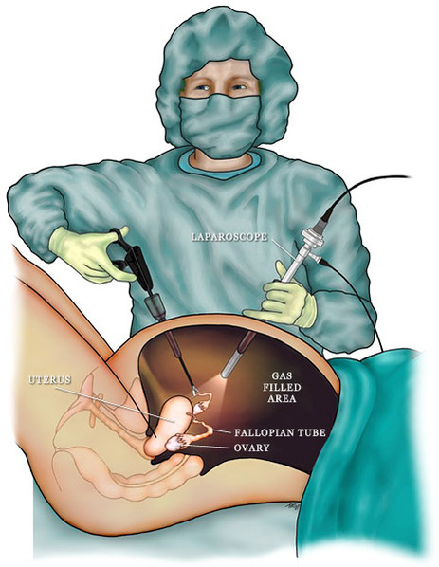
SAFE ENTRY IN LAPAROSCOPY
Yasser Orief M.D., PhD.
Lecturer of Obstetrics & Gynecology, Alexandria University
Fellow, Lϋbeck University, Germany
DGOL, Auvergné University, France

Slide 2
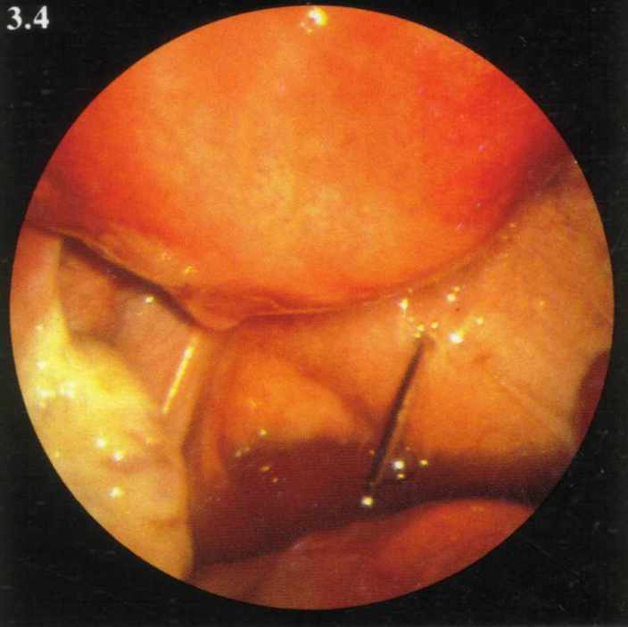
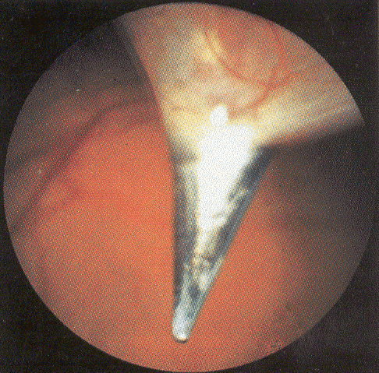
Approximately 50% of all complications during laparoscopy are entry-related.
One in 4 is not diagnosed during the operation
Stoval&Mann,Up to date,May2011. Margina,Clin Obstet Gynecol2002,45:469 Seven top French centers 29 966 cases
Notes:
Slide 8

Slide 3
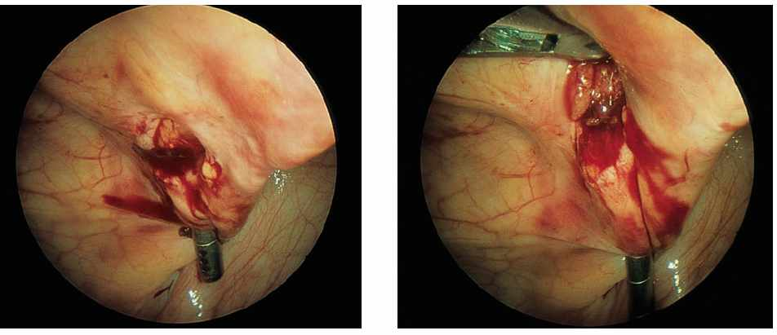
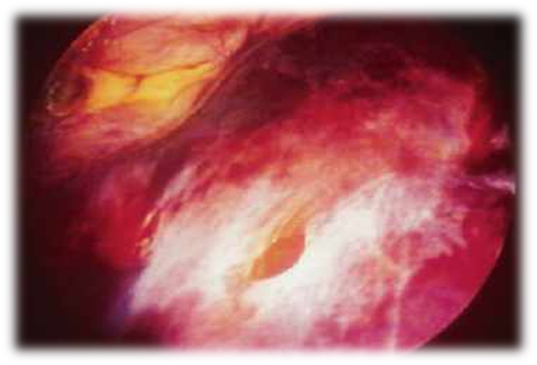
Entry-Related complications
Blood Vessel Injuries
Small: Omental or mesenteric
Major: Abdominal or pelvic artery or vein
Epigastric vessel perforation
Retroperitoneal hematoma due to vena cava injury with the Veress needle

Slide 4
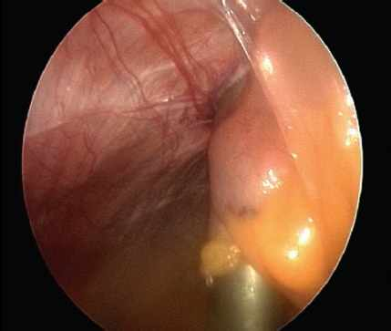
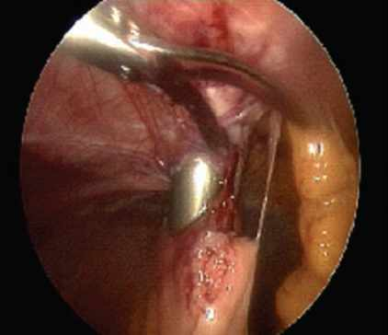
Bowel Injuries
Perforation of the small bowel by 10-mm trocar

Slide 5
Insufflation of the subcutaneous or preperitoneal space:
1-Subcutaneous emphysema.
2-Complicating visibility.

Slide 6
How to diminish entry-related complications?
Surgeon’s experience is the most important
1-Understanding of relvant anatomy.
2-Proper use of surgical instruments.
3-Choice of optimal surgical technique.
4-Ability to detect and manage complications
Jansen et al. Complications of laparoscopy: a prospective multicentre observational study. Br J Obstet Gynecol. 2008

Slide 7
The Surgeon Should Follow The Safe abdominal entry guidelines for:
Position of the patient.
Placement of the veress needle.
Pneumoperitoneum.
Primary (umbilical) trocar insertion.
Accessory (secondary) trocars.
Identification of high risk patients.
Notes:
Slide 8

Slide 8
High Risk Patients For Abdominal Entry
Body weight(Obesity,slimmness).
Large pelvic mass.
Previous abdominal and pelvic operations.
Strong abdominal musculature.
Previous radiation therapy.
Bowel distension.

Slide 9
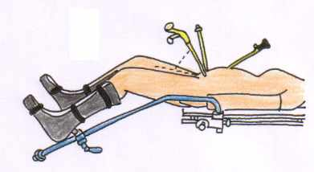
Position of the Patient
The patient is positioned in the dorso-lithotomy position with lowered legs.
Notes:
Slide 8

Slide 10
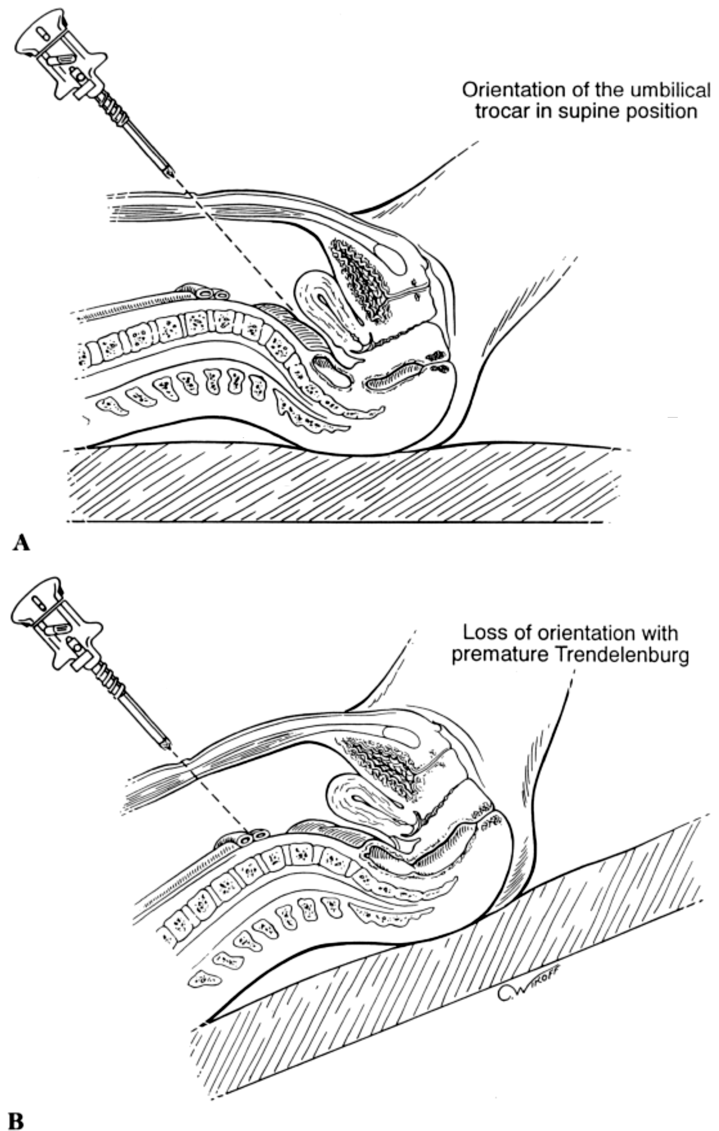
Position of the Patient
The operating table should be in the flat position
Early Trendelenburg position may lead to major vascular injury.
Notes:
Slide 8

Slide 11


Slide 12
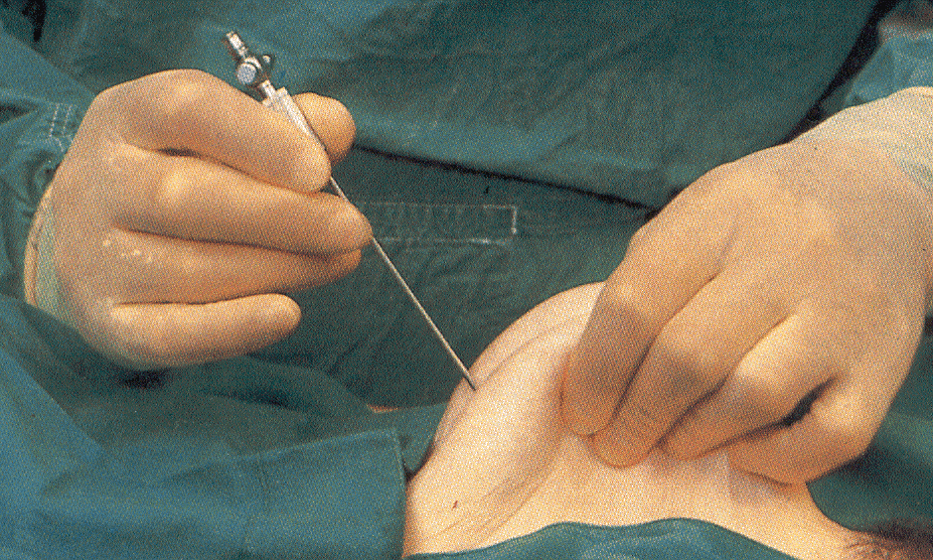
Placement of Veress Needle
The umbilicus is the ideal site of choice for insertion:
  The thinnest area
  Minimal subcutaneous fat even in obese women.
  Fusion of fascial layers with the peritoneum
Notes:
Slide 8

Slide 13
Placement of Veress Needle
Before insertion, the needle is checked for patency and spring mechanism
The angle of insertion is usually 90º to the skin, then it is readjusted according to thickness of abdominal wall: 45º in thin women to 90º in obese women.
Notes:
Slide 8

Slide 14
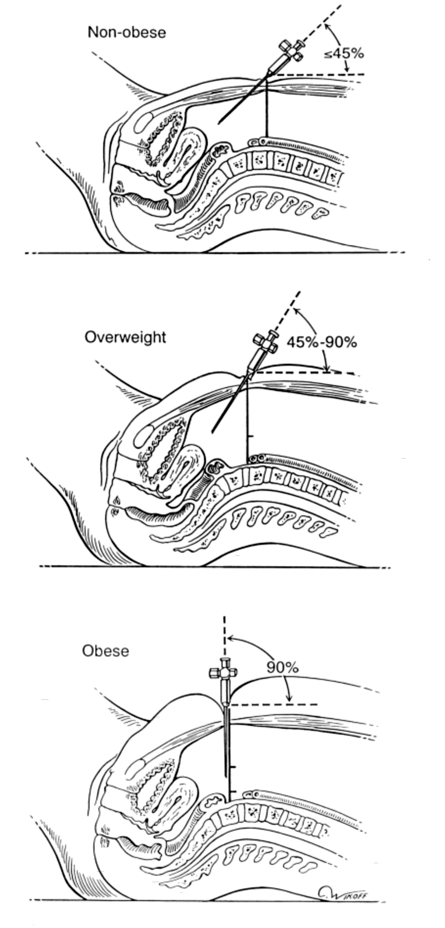
Weight < 75 Kg

Slide 15
Weight < 75 Kg
Angle of isertion = 45°

Slide 16
95 kg > Weight > 75 Kg
Angle of insertion = 45°- 90°

Slide 17
Weight > 95 Kg

Slide 18
Weight > 95 Kg
Angle of insertion = 90°

Slide 19
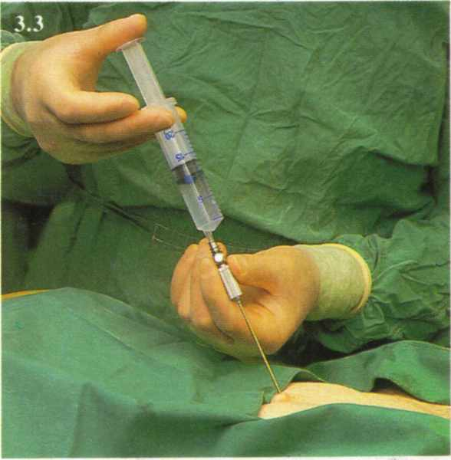
Veress needle Safety Tests Or Checks
Provide very little useful information on the placement of the veress needle.
It is therefore not necessary to be performed.
SOGC Practice Guideline. 193, 2007

Slide 20
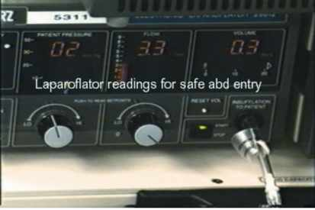
What Is The Most Reliable Safety Test ?
The Veress intraperitoneal (VIP) pressure ≤ 10 mm Hg
Therefore, it is appropriate to attach the CO₂ source to the Veress needle on entry.
SOGC Practice Guideline.193, 2007

Slide 21
Guidelines for Safe Veress Needle Abdominal Entry
Aim to sacral hollow.
Aim at right angle to the skin, then readjust.
Aim away from pelvic vessels.
Test for peritoneal entry (IPP ≤ 10 mm Hg).
Advance only 2-3 cm after piercing peritoneum.
Avoid over-insufflation.
RCOG Guideline No 49 May 2008

Slide 22
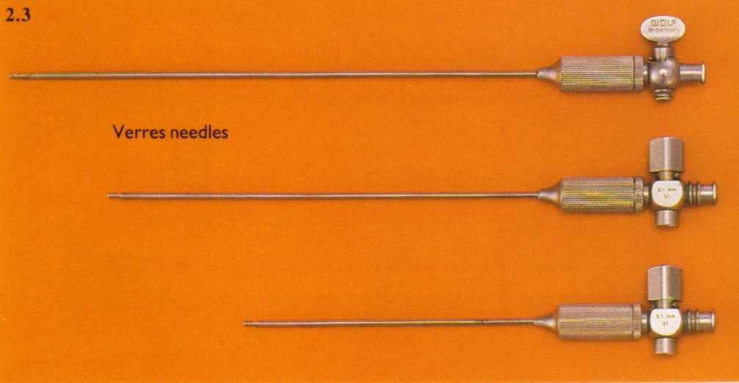
Avoid:
Long Needle.
Premature Trendelnburg.
Distension: stomach, colon or bladder.
Adhesions.

Slide 23
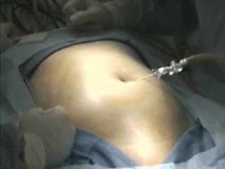
Pneumoperitoneum
Adjust intra-peritoneal pressure to 12-16 mm Hg once insertion of trocar is complete.
SOGC Practice Guideline. 193, 2007

Slide 24
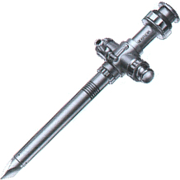
Types Of Primary Trocar
1-Non-Visual Entry System:
  Conventional trocar and cannula
  Disposable shielded trocars
  Reusable shielded safety trocars
  Radially expanding(Versa step)
2-Visual Entry Systems
3-Open laparoscopy (Hasson)

Slide 25
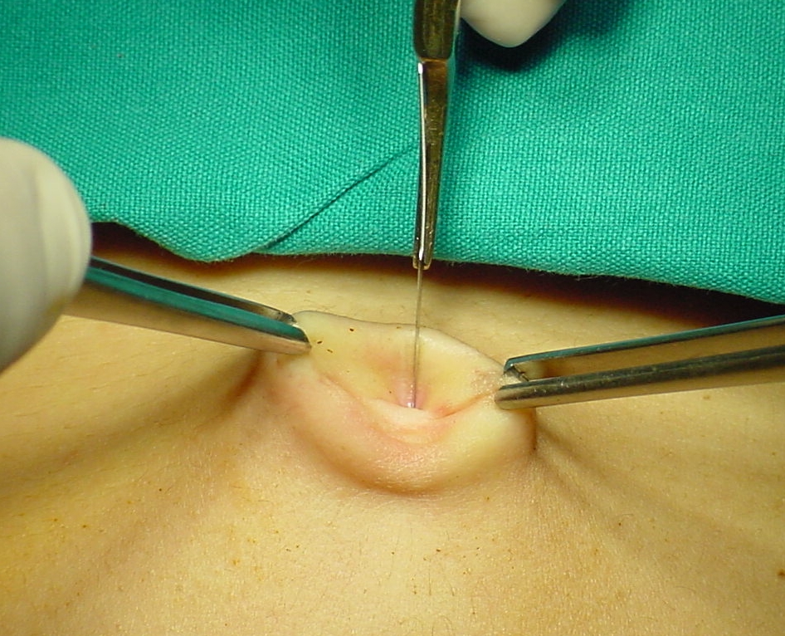
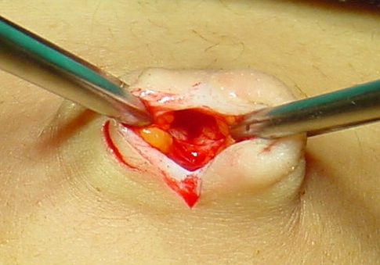
Trocar introduction
The primary incision should be vertical from the base of the umbilicus
RCOG Guideline no 49, May 2008

Slide 26
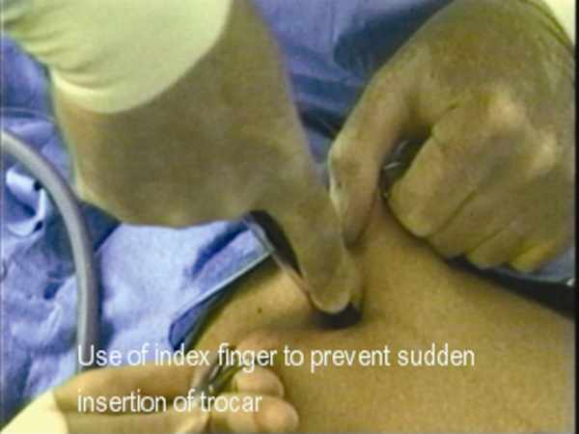
Guidelines for Safe Primary Trocar Entry
Aim at right angle to the skin, then readjust 45-90º.
Aim to sacral hollow,aim away from pelvic vessels.
Extend index on the trocar to prevent sudden thrust of trocar.
Rotate in a semi-circular fashion.
Advance not more than 2-3 cm beyond peritoneum.
RCOGGuideline No 49 May 2008
Pryor&Yoo,Up to date, May 2011

Slide 27
Once introduced check visually for any evidence of hemorrhage or damage.
Visual control during removal is also recommended.
RCOG Guideline No.49 May 2008
Xavier Deffieux et al, Risks associated with laparoscopic entry:guidelines for clinical practice from the French
College of Gynecologists and Obstetricians, 2011

Slide 28
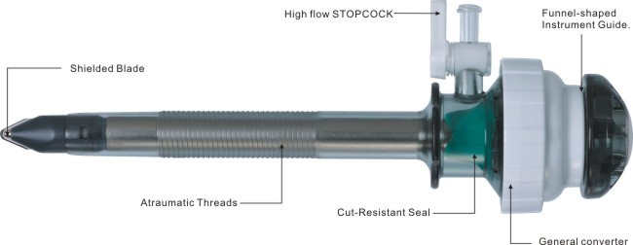
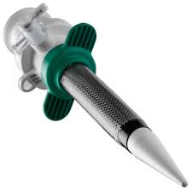
There is no evidence that shielded trocars result in fewer visceral and vascular injuries.
Radially expanding trocars(Versastep) may provide some protection from injuries but neeeds greater force for introduction.
Xavier Deffieux et al, Risks associated with laparoscopic entry:guidelines for clinical practice from the French College of Gynecologists and Obstetricians,2011

Slide 29
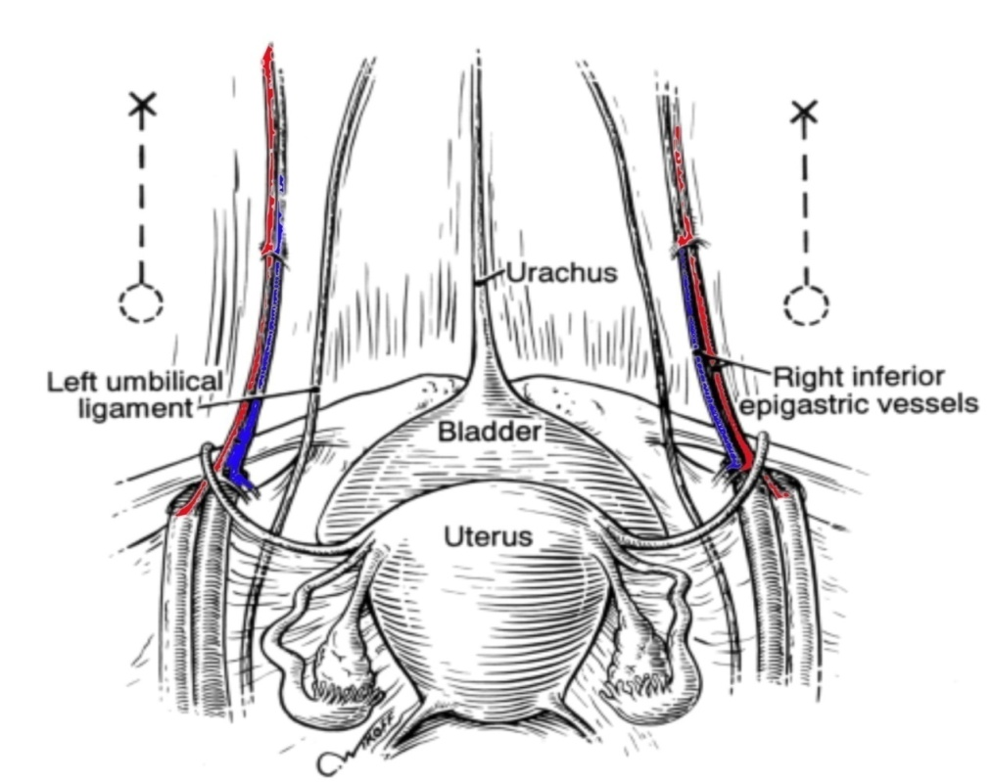
Secondary Trocar Insertion:
The structures most frequently injured are:
Inferior epigastric vessels
Inferior epigastric artery lesions
76,5% of all vascular complications
0,3% of all complications

Slide 30
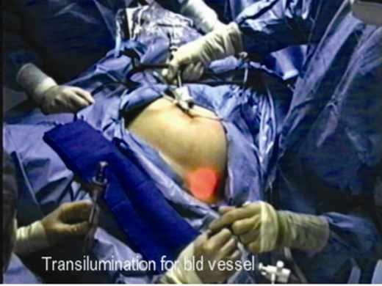
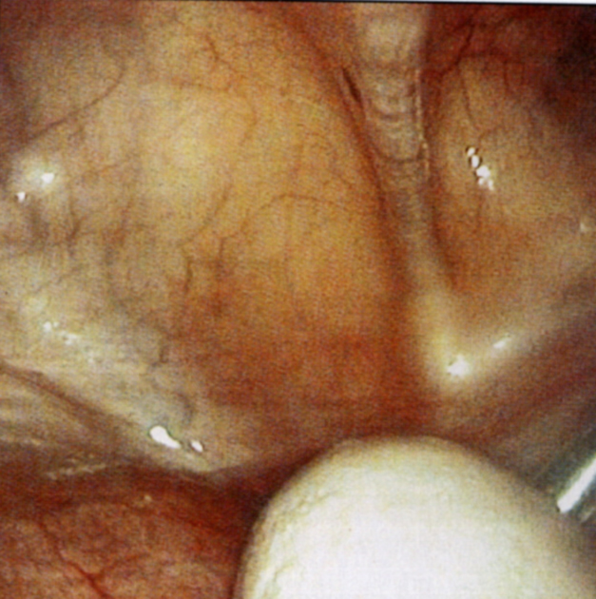
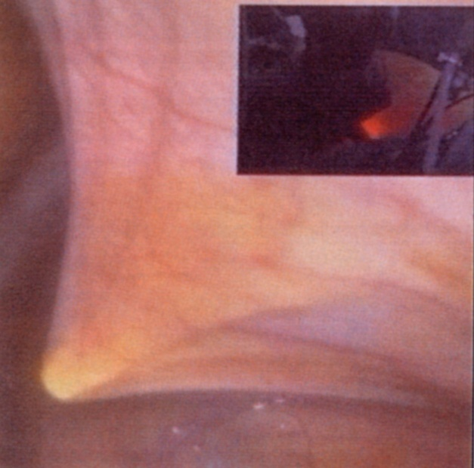
Accessory Trocars: Golden safety rules:
Transillumination and under endoscopic direct vision.
Lateral umbilical ligament
Introduction of ancillary trocar under laparoscopic control
Notes:
Slide 8

Slide 31
When laparoscopic landmarks are not visible, secondary trocars should be placed 5 cm superior to the midpubic symphysis and 8 cm lateral to the midline to avoid injury to the vessels of the anterior abdominal wall.
Manvikar Purushottam Rao et.al, Study of the course of inferior epigastric artery with reference to laparoscopic portal, 2013 | Volume : 9 | Issue : 4 | Page : 154-158

Slide 32
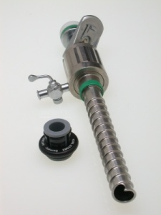
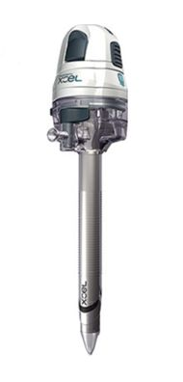
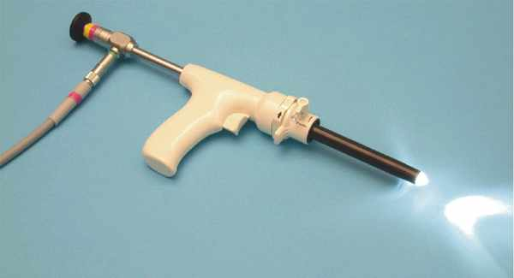
Visual Entry Systems
DISPOSABLE:
  Optiview
  Visiport
REUSABLE:
  Endo TIP
  Gaseless laparoscopy

Slide 33
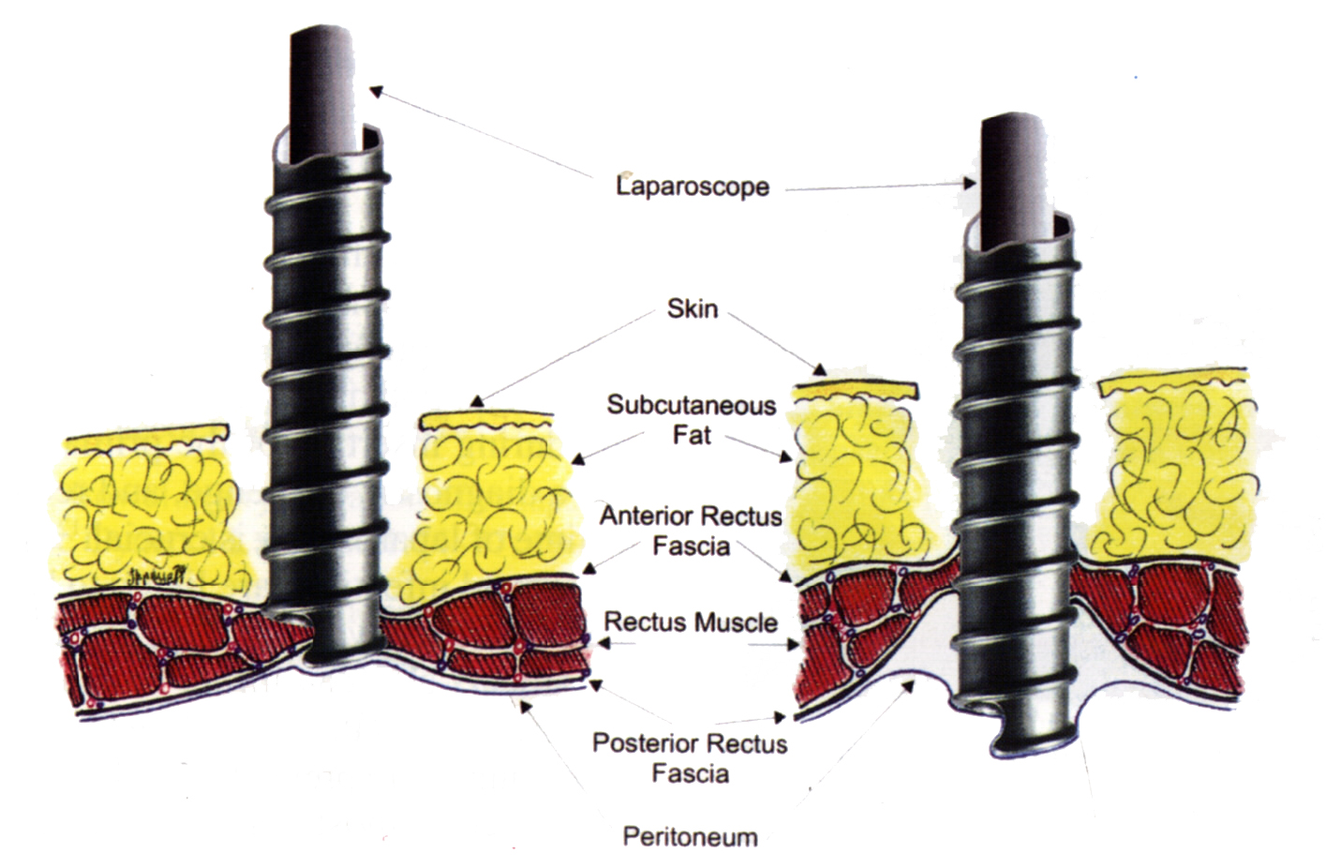
Visual access cannula introduced by clockwise rotation
All the abdominal layers are well visualized
Notes:
Slide 8

Slide 34
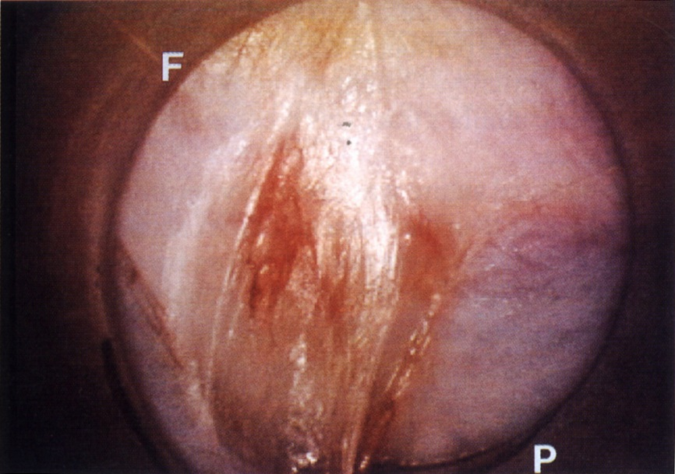
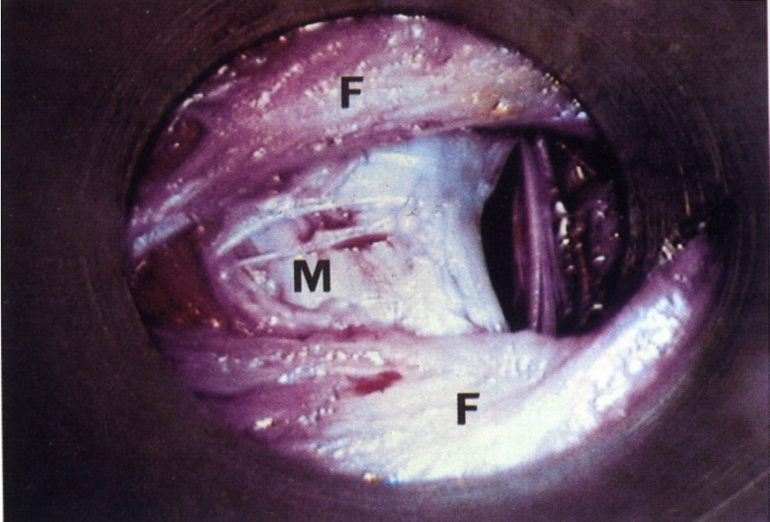
Advantages:
  Clear optical entry.
  Minimize entry wound.
  Reduce the insertion force.
  No tissue cutting but dilation.
  Integrity of fascial layers.
Thin transparent peritoneum (P) as seen under visual control
Counter-clockwise rotation of the cannula at the end of the operation

Slide 35
Management Of Abdominal Wall Access With probable Intraperitoneal Adhesions:
1-Open laparoscopy.
2-Direct veress needle with optic catheter.
3-Alternative access sites and techniques.
4-Peri-umbilical ultrasound- guided saline infusion technique (PUGSI).

Slide 36
Open Laparoscopy (Harrith Hasson, 1971)
The RCOG recommends the open (Hasson) technique to be used in all circumstances especially very thin and morbidly obese.
RCOG Guideline No 49 May 2008
Significant reduction of failed entry but no difference in incidence of visceral or vascular injury.
Jongrak Thepsuwan et. al, Principles of safe abdominal entry in laparoscopic gynecologic surgery, Gynecology and minimally Invasive therapy vo l2, Issue 4, 105-109, November 2013
Notes:
Slide 8

Slide 37
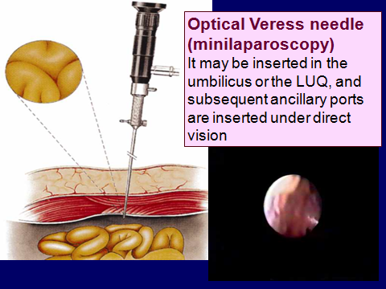
Direct veress needle with optic catheter

Slide 38
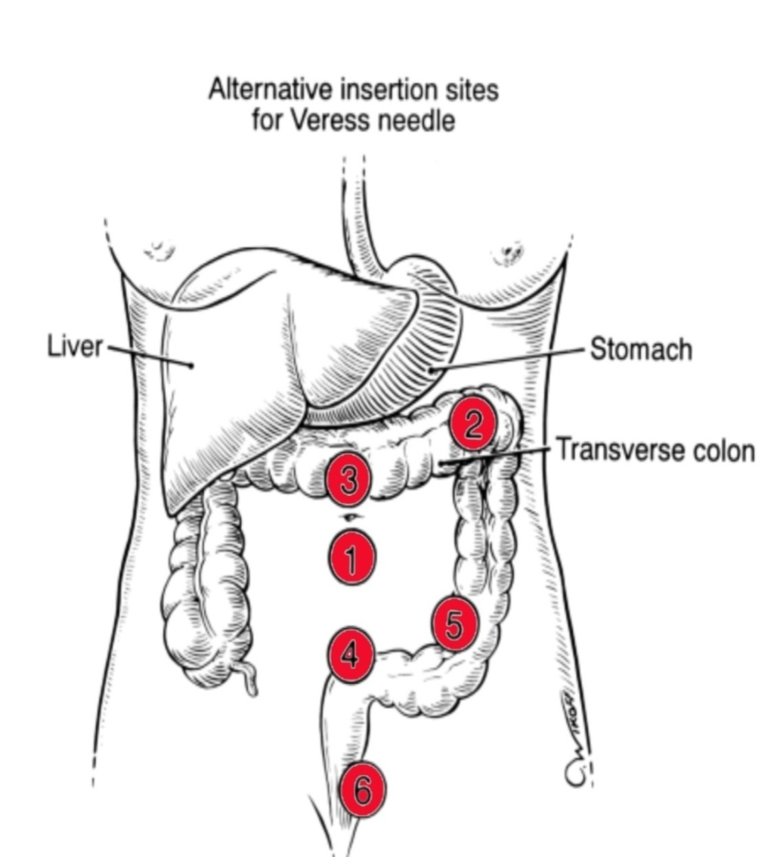
Alternate Sites of Veress needle insertion
1- Umbilical
2- Left subcostal (midclavicular)
3 -Median supra-umbilical
4 -Median supra-pubic
5 -Left iliac fossa(LLQ)
6 -Transcervical,transvaginal

Slide 39
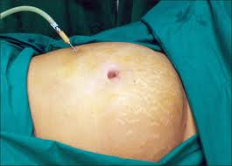
Left upper quadrant entry
Palmer’s Point:
on the midclavicular line
3 finger widths off the upper midline.
3 finger widths below the left costal margin.
Pre-requisites:
Gastric emptying(NGT).
No history of splenic or gastric surgery.
No hepatosplenomegaly or gastric masses.
Notes:
Slide 8

Slide 40
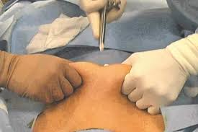
Direct Insertion Of trocar without prior Pneumoperitoneum
Considered a safe alternative to veress needle technique to avoid complications of:
  Failed pneumoperitoneum.
  Preperitoneal insufflation.
  Carbon dioxide embolism
Faster BUT least performed
Molloy et al, Aust NZJ Obstet Gynecol 2002; 42:246-54
SOGC PRACTICE Guideline.193,2007
Notes:
Slide 8

Slide 41
Periumbilical Ultrasound-guided Saline Infusion technique (PUGSI)
A novel technique that involves the injection of a small amount of sterile saline into the area of laparoscopic entry to detect subumbilical adhesions perioperatively.
Nezhat C etal. Fertil Steril 2009; 91(6): 2714-9.

Slide 42
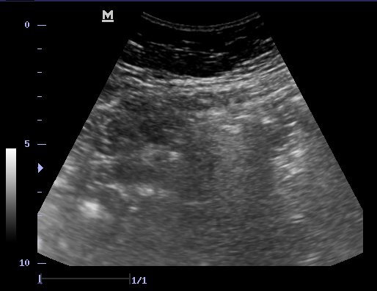
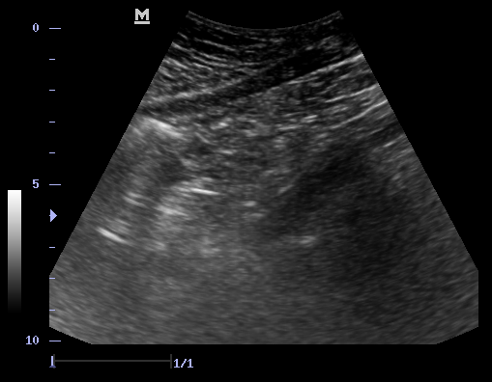
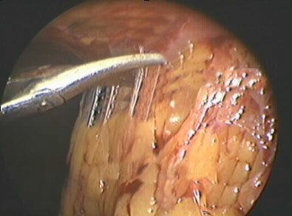
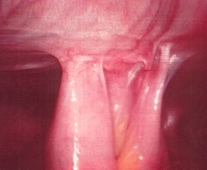
Fluid pockets
Fluid pockets
Intestinal adhesions
Omental adhesions

Slide 43

What is the best techninque??
2009
No single technique is significantly better in reduction of the incidence of serious complications.

Slide 44
CONCULSIONS
Minimizing entry-related complications entails:
Surgeon’s skill and knowledge.
Proper patient position.
Understand anatomical landmarks & relations.
Follow abdominal entry guidelines.
Beware of high risk patients.
Use proper instruments and alternative strategies.

Slide 45
a/r

