Slide 1
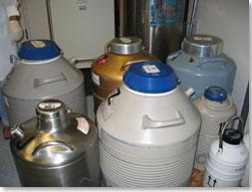
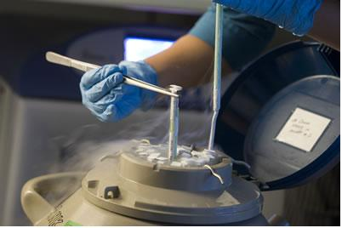
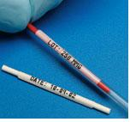
Vitrification
and
fertility preservation
Yasser Orief MD, PhD.
Assisstant Professor of Obstetrics & Gynecology, Alexandria University, Egypt
Fellow, Lubeck University, Germany

Slide 2
Preservation of fertility
The application of medical, surgical and laboratory procedures to preserve the potential of genetic parenthood in adults and children at risk of sterility before the end of natural reproductive lifespan
(Gosden 2009)

Slide 3
Who needs to consider preservation of Fertility?
Cancer patients before gonadotoxic treatment
Other diseases before gonadotoxic treatment (Systemic lupus, rheumatoid arthritis...)
Individuals exposed to accelerated loss of oocytes due to genetic disease (Turner syndrome, Fragile X premutation (FMR 1), Galactosemia)
Fertility extension. Women delaying pregnancy for career or social reasons

Slide 4
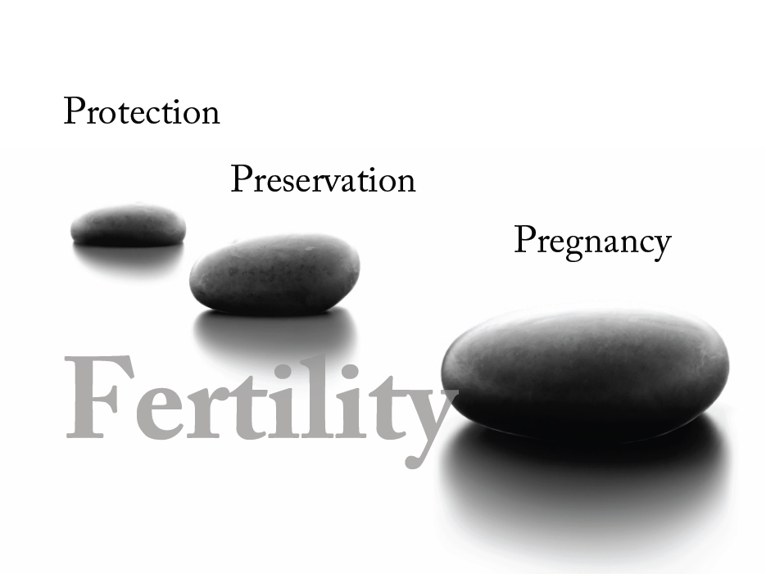

Slide 5
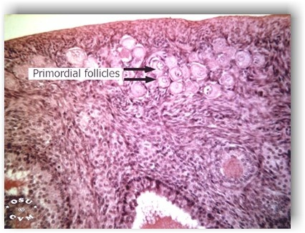
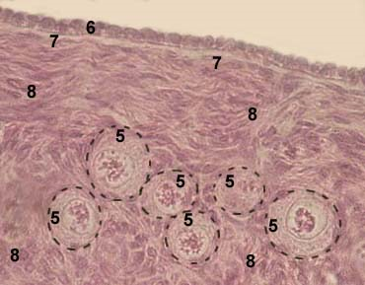
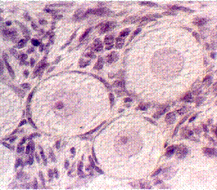
Pharmacological
Protection
GnRha may prevent follicles from reaching the cytotoxic threshold by decreasing mitotic activity in the granulosa cells
American Society of Clinical Oncology (ASCO) Guideline 2013
Oktay K. Fertility preservation in female patients, Human Reproduction Update, Vol.10, No.3 pp. 251±266, 2004
Notes:
Chemotherapy mainly damage the very small follicles. These are not responsive to hormones in the blood.
American Society of Clinical Oncology (ASCO) Guideline 2013
Ovarian suppression with gonadotropin releasing hormone (GnRH) analogs or antagonists (I)
Use of hormonal therapies to protect ovarian tissue during chemotherapy or radiation therapy
Small randomized studies and case series. Larger randomized trials in progress
Medication given before and during treatment with chemotherapy
Approximately $500/mo
These follicles are at resting stage with
an oocyte arrested at the prophase of ®rst meiotic division.
Primordial follicles initiate follicle growth through an unknown
mechanism which is FSH independent (Gougeon, 1996; Oktay
et al., 1997b, 1998a; McNatty et al., 1999; Meduri et al., 2003).
FSH receptors are not expressed in primordial and primary
follicles, but the expression is uniformly present in as early as 3±4
granulosa layer preantral follicles. It is possible that ovarian
suppression with GnRH analogues preserves these follicles that
have initiated growth. However, growing follicles not only
constitute <10% of all follicles at any given time in the ovary,
but once growth has been initiated, they are destined either to
become atretic or to ovulate. It is quite possible that GnRH
analogue co-treatment delays the fate of these follicles, hence
giving the impression that ovarian function is protected in the short
run. It has also been suggested that the effects of GnRH analogues
may be explained through direct actions of GnRH in the ovary
(Blumenfeld, 2003). It was shown that luteinized immortalized
granulosa cell lines express GnRH receptors (Cheng et al., 2002);
however, to our knowledge, presence of these receptors on human
primordial follicles or oocytes has never been demonstrated. A
clinical example for why gonadal suppression may not protect
ovaries is the fact that pre-pubertal children receiving heavy
chemotherapy still suffer from ovarian failure (Teinturier et al.,
1998). However, since younger patients have a larger ovarian
reserve, absence of immediate ovarian failure does not mean that
gonads are unaffected by the chemotherapy (Meirow et al., 1999).
All of the patients who receive heavy gonadotoxic chemotherapy
will eventually suffer from premature ovarian failure (Viviani
et al., 1999; Grigg et al., 2000). In the absence of a prospective
randomized study with suf®cient power, we do not rely on ovarian
suppression as an effective means of fertility preservation.

Slide 6
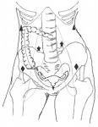
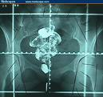
Surgical Protection
Ovarian transposition
(The ovarian dose is reduced by transposition to 5–10%)
Medial transposition
Lateral transposition
Behind the uterus.
up to the pelvic side wall at least 3cm from the upper border of the radiation field.
89% spontaneous pregnancy with 75% occurring without repositioning.
11% conceived with IVF.
However :
Fallopian tube infarction.
Chronic ovarian pain.
Ovarian cyst formation.
Migration of ovaries back to their original position.
American Society of Clinical Oncology (ASCO) Guideline 2013
Notes:
techniques * by laparotomy during surgery.
* by laparoscopy
- higher doses of radiation are more likely associated
with vascular damage of transposed ovaries.
89% spontaneous pregnancy with 75%
occurring without repositioning.
11% conceived with IVF.
Controversies regarding pregnancy outcomes
after pelvic irradiation.
? Increase fetal wastage
? Birth defects
? Low birth weight
? Abnormal karyotype
? Cancer in the offspring
? Spontaneous abortions
Complications of oophropexy
Fallopian tube infarction.
Chronic ovarian pain.
Ovarian cyst formation.
Migration of ovaries back to their original
position.
Ovarian metastasis (No increased risk).

Slide 7
Options for fertility preservation
Should be tailored according to:
Patient’s age
Type of disease
Spread of the disease
Planned treatment
Time available
Whether she has a partner
(Holzer Tan 2005)

Slide 8
Male fertility preservation
Intervention | Definition | Comment | Considerations
Sperm cryopreservation (S) | Freezing sperm obtained through masturbation | The most established technique for fertility preservation in men; large cohort studies in men with cancer | Outpatient procedure Approximately $1,500 for three samples stored for 3 years, storage fee for additional years*
Gonadal shielding during radiation therapy (S) | Use of shielding to reduce the dose of radiation delivered to the testicles | Case series | Only possible with selected radiation fields and anatomy Expertise is required to ensure shielding does not increase dose delivered to the reproductive organs
Testicular tissue cryopreservation Testis xenografting Spermatogonial isolation (I) | Freezing testicular tissue or germ cells and reimplantation after cancer treatment or maturation in animals | Has not been tested in humans; successful application in animal models | Outpatient surgical procedure
Testicular suppression with gonadotropin releasing hormone (GnRH) analogs or antagonists (I) | Use of hormonal therapies to protect testicular tissue during chemotherapy or radiation therapy | Studies do not support the effectiveness of this approach
Abbreviations: S, standard; I, investigational.
American Society of Clinical Oncology (ASCO) Guideline 2013

Slide 9
Fertility preservation strategies
High risk of ovarian involvement
Low risk of ovarian involvement
Ovarian tissue cryopreservation
IVM
Xenografting
Radiotherapy
chemotherapy
Ovarian transposition
Chemotherapy can be delayed (4-6weeks)
Chemotherapy can not be delayed
Ovarian tissue cryopreservation
Autograft
Heterograft
Oocyte / embryo cryopreservation
Estrogen sensitive tumor
Estrogen insensitive tumor
Ovarian tissue cryopreservation
Conventional stimulation protocols
O/I with Tamoxifen or Letrozole

Slide 10
Preservation of Fertility
Embryo Cryopreservation
Oocyte Cryopreservation
Ovarian tissue cryopreservation
Slow freezing
Vitrification

Slide 11
Vitrification
Vitrification is the glass-like solidification of a solution at a low temperature without ice crystal formation, which is made possible by extreme elevation in viscosity during freezing. This can be achieved by increasing the freezing and warming rates and/or increasing the concentration of the cryoprotectants .
  Claims made for vitrification
  Reduces the time of the cryopreservation procedure
  Flexibility
  Eliminates the cost of expensive programmable freezing equipment
  No ice crystallization
  Very simple procedure
Notes:
Unlike slow freezing, vitrification results in the total elimination of ice crystal formation, both within the cells being vitrified and outside the cells in the surrounding solution .
Ultra-rapid freezing can be considered a midway technique between slow freezing and vitrification. It is quicker than the slow-freezing technique, does not involve the use of programmable machines and requires lower concentrations of cryoprotectant agents (CPA) than those used in vitrification

Slide 12


  Succesfull vitrification of human oocytes, embryos and blastocysts depends on a correct interplay between, “sufficient” permeation of a “sufficient” high concentration of penetrating cryoprotectant (equilibration step), “sufficient” dehydration by a non-penetrating cryoprotectant (vitrification step), a “sufficient” high cooling rate (direct contact with LN2 and small volumes) and a “sufficient” high warming rate
1 sec.
- 0.3°C/min
- 50.000°C/min
Slow freezing
Vitrification
Notes:
Challenge
Succesfull vitrification of human oocytes, embryos and blastocysts depends on a correct interplay between, “sufficient” permeation of a “sufficient” high concentration of penetrating cryoprotectant (equilibration step), “sufficient” dehydration by a non-penetrating cryoprotectant (vitrification step), a “sufficient” high cooling rate direct contact with LN2 and small volumes) and a “sufficient” high warming rate

Slide 13
Embryo
Cryopreservation

Slide 14
Embryo Cryopreservation
This method requires
Ovarian stimulation with fertility medication
Time; 2-3 weeks
Sperm source (partner )

Slide 15
Embryo Cryopreservation
Study | Country | Study period | Interventions | Method of randomization | No. of participants (No. of cycles) | Financial support
Bernal et al. (2008) | USA | January 2007–April 2008 | Vitrification versus slow programmed freezing | Alternate randomization | 115 women (64:51) | No external financial support
Kim et al. (2000) | Korea | January 1998–July 1999 | Vitrification versus slow programmed freezing | Unclear | Unclear (42:216) | None declared
Li et al. (2007) | China | June 2005–March 2007 | Vitrification versus slow programmed freezing | Alternate randomization | 80 women (40:40) | None declared
Mauri et al. (2001) | Brazil | January 1991–March 2000 | Ultra-rapid freezing versus slow programmed freezing | Computer-generated randomization list | 160 women (80:80) | No external financial support
Rama Raju et al. (2005) | India | May 2004–June 2005 | Vitrification versus slow programmed freezing | Unclear | 164 women (84:80) | None declared
Van den Abbeel et al. (1997a) | Belgium | October 1992–March 1993 | Ultra-rapid freezing versus slow programmed freezing | Randomization list | Unclear (100:100) | Belgium National Fund for Medical Research
Characteristics of included studies
Faten F. Slow freezing, vitrification and ultra-rapid freezing of human embryos: a systematic review and meta-analysis, RBM online 2009

Slide 16
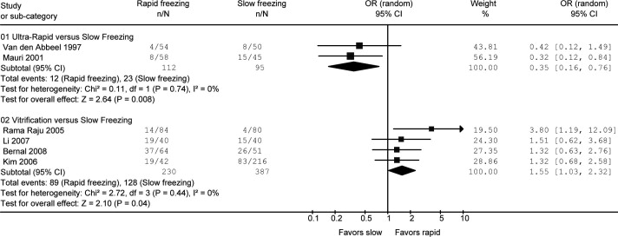
Embryo Cryopreservation
Forest plot for clinical pregnancy rate
Faten F. Slow freezing, vitrification and ultra-rapid freezing of human embryos: a systematic review and meta-analysis, RBM online 2009

Slide 17
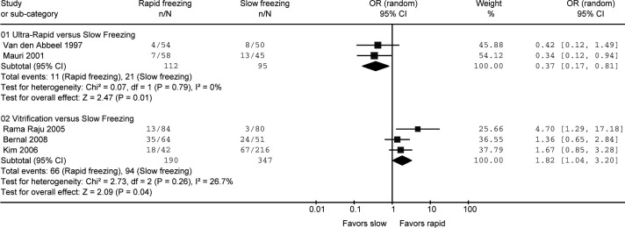
Embryo Cryopreservation
Forest plot for ongoing pregnancy rate.
Faten F. Slow freezing, vitrification and ultra-rapid freezing of human embryos: a systematic review and meta-analysis, RBM online 2009

Slide 18
Embryo Cryopreservation
Comparison | Method | PN stage | Cleavage stage | Blastocyst stage
Embryo stage at time of cryopreservation
Vitrification versus slow freezing | Direct analysis | NA | 2.22 (0.91–5.43) | 1.32 (0.81–2.17)
Ultra-rapid freezing versus slow freezing | Direct analysis | 0.42 (0.12–1.49) | 0.32 (0.12–0.84)ª | NA
Vitrification versus ultra-rapid freezing | Adjusted indirect analysis | NA | 0.14 (0.04–0.54)ª | NA
Embryo stage at time of embryo transfer
Vitrification versus slow freezing | Direct analysis | NA | 2.22 (0.91–5.43) | 1.32 (0.81–2.17)
Ultra-rapid freezing versus slow freezing | Direct analysis | NA | 0.35 (0.16–0.76)ª | NA
Vitrification versus ultra-rapid freezing | Adjusted indirect analysis | NA | 0.16 (0.05–0.52)ª | NA
Clinical pregnancy rates for subgroup analyses.
Values are odds ratio (95% confidence interval); NA = not applicable; PN = pronuclear.
a Statistically significant.
Faten F. Slow freezing, vitrification and ultra-rapid freezing of human embryos: a systematic review and meta-analysis, RBM online 2009
Notes:
Ultra-rapid freezing protocols for human embryo cryopreservation
Compared with slow freezing, this technique
required a shorter duration of embryo exposure to the
CPA but at a higher concentration. In comparison with vitrification,
ultra-rapid freezing used far lower concentrations
of CPA and it was suggested that the relatively lower CPA
concentrations may result in less toxicity (Van den Abbeel
et al., 1997b). The problem of intra-cellular ice crystal formation
in the cell(s) being frozen was still however a problem.
This may be a contributing factor to the variable (but
generally low) clinical pregnancy rates achieved with the ultra-
rapid freezing technique, which have for the most part
hindered the widespread adoption of this technology in clinical
laboratories.
In the current study, embryo cryopreservation by slow
controlled-rate freezing, ultra-rapid freezing and vitrification
were compared. Results of the current meta-analysis
indicate that embryo vitrification is superior to slow freezing
based on direct comparison of embryo survival and clinical
pregnancy rates. Ongoing pregnancy and implantation
rates were also higher with vitrification as compared with
slow freezing. Within the limited data set available, using
both direct and indirect evidence, ultra-rapid freezing appeared
to be inferior to slow programmed freezing as well
as vitrification.

Slide 19
Oocyte
Cryopreservation

Slide 20
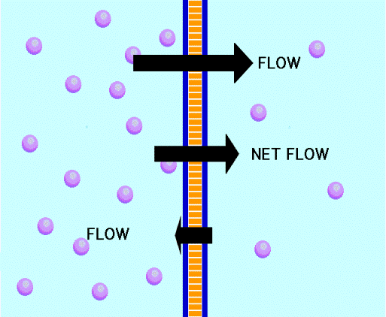
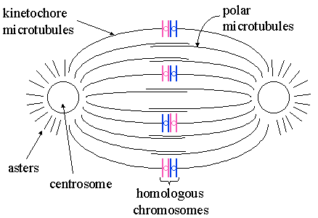
Oocyte Cryopreservation
It’s the largest cell in the body
It has a lot of water content
Its cell membrane does not allow water to pass easily
Chromosomes are spread on a spindle
A special expertise is required for oocyte cryopreservation

Slide 21
Oocyte Cryopreservation
 | Slow freezing | Vitrification
Oocytes thawed | 11937 | 1346
Oocytes survived | 7610 (63.8%) | 1233 (91.6%)
Oocytes injected | 6871 | 1123
Oocytes fertilized | 5029 (73.2%) | 964 (91%)
Clincal pregnancy per oocytes thawed | 275 (2.3%) | 157 (8.8%)
Miscarriage rate | 21.8% | 16.8%
Azim et al, Fertility Sterility 2010
Meta analysis (38 studies)

Slide 22
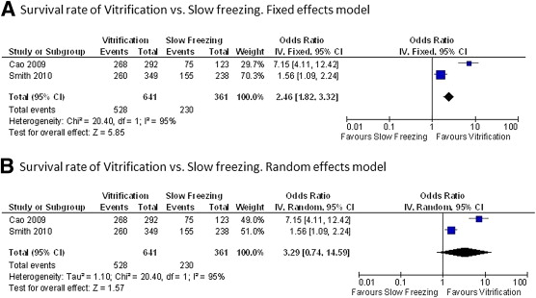
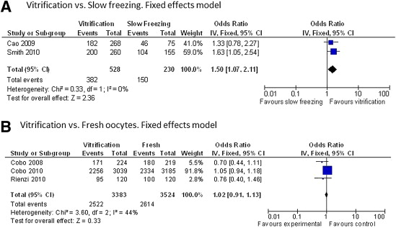
Oocyte Cryopreservation
Oocyte survival rate (Vitrification vs. Slow freezing)
Fertilization rate (Vitrification vs. Slow freezing)
Cobo A, Diaz C., Clinical application of oocyte vitrification: a systematic review and meta-analysis of randomized controlled trials. Ferility and Sterility 2011)
.
Notes:
Conclusions
More studies should be done!
The oocyte survival rate was higher in vitrified vs. slow-frozen oocytes (odds ratio [OR] 2.46, 95% confidence interval [CI] 1.82-3.32), although heterogeneity between studies was observed.
The fertilization rate was higher in vitrified vs. slow-frozen oocytes (OR 1.50, 95% CI 1.07-2.11).
Vitrification also resulted in a higher rate top-quality embryo (22.4% vs. 8.0%, OR 3.32, 95% CI 1.37-8.02) and embryo cleavage rate (day 2: 64.6% vs. 47.7%, OR 2.00, 95% CI 1.33-3.00; day 3: 53.0% vs. 33.3%, OR 2.25, 95% CI 1.32-3.85) as compared with slow freezing

Slide 23
Oocyte Cryopreservation
Vitrification vs. fresh oocytes
The rates of fertilization, embryo cleavage, top-quality embryo, and ongoing pregnancy did not differ between the vitrification and the fresh oocyte groups
Cobo A, Diaz C., Clinical application of oocyte vitrification: a systematic review and meta-analysis of randomized controlled trials. Ferility and Sterility 2011)
.

Slide 24
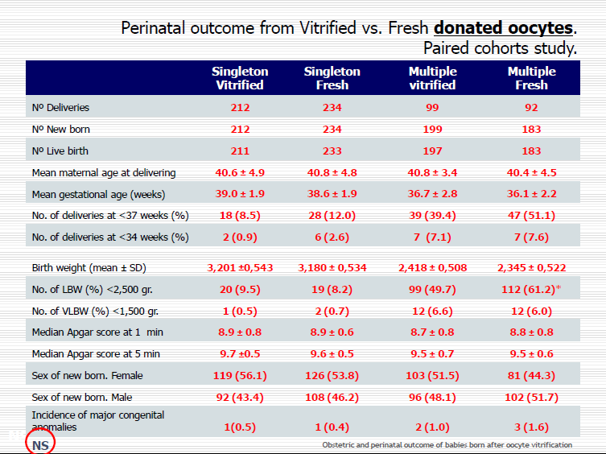
Oocyte Cryopreservation
Perinatal outcome from vitrified vs. fresh oocytes
(Paired cohorts study)
Azim et al, Fertility Sterility 2010
Meta analysis (38 studies)

Slide 25
Ovarian Tissue Cryopreservation

Slide 26
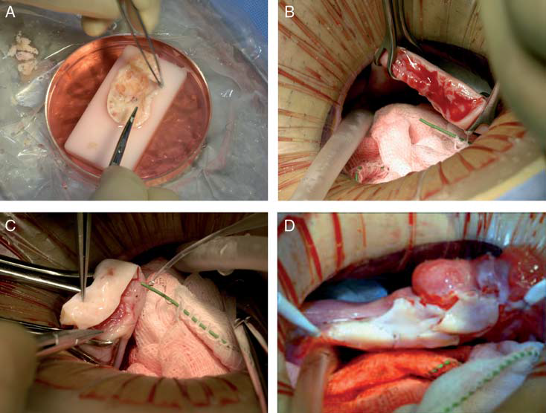
Ovarian Tissue Cryopreservation
Embryo / oocyte cryopreservation | Ovarian tissue cryopreservation
Women willing to conceive | girls
Oncologist approval for stimulation | Contraindication for stimulation
Advantages Successful rate similar to fresh cycles Established technique | Advantages Numerous cycles (up to two years) maintain hormonal function
Restrictions Limited IVF cycles Does not guarantee pregnancy Delay CT treatment | Restrictions Experimental Need surgery Harboring cancer cells

Slide 27
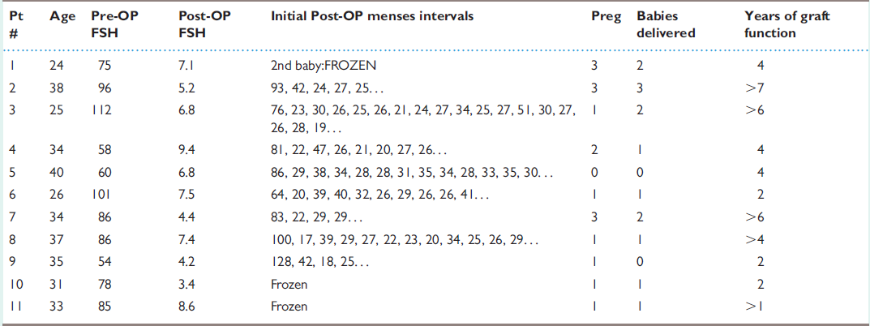
Ovarian Tissue Cryopreservation
Ovarian transplant results (14 babies: 11 from 9 fresh and 3 from 3 frozen).
Eleven MZ twin pairs presented with discordant ovarian function, one sibling normal and the other having POF.
All frozen cortical tissues was done by the slow freezing technique
S.J. Silber. Ovary cryopreservation and transplantation for fertility preservation. Molecular Human Reproduction, Vol.18, No.2 pp. 59–67, 2012
S.J. Silber, Molecular Human Reproduction, Vol.18, No.2, 2012)

Slide 28
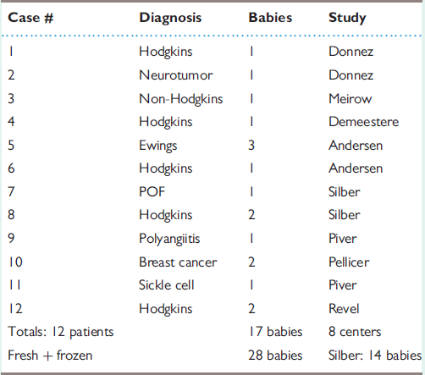
Ovarian Tissue Cryopreservation
Worldwide frozen ovarian cortical tissue transplantation pregnancies.
S.J. Silber. Ovary cryopreservation and transplantation for fertility preservation. Molecular Human Reproduction, Vol.18, No.2 pp. 59–67, 2012

Slide 29
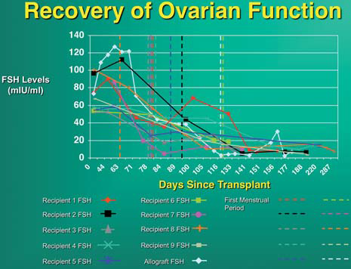
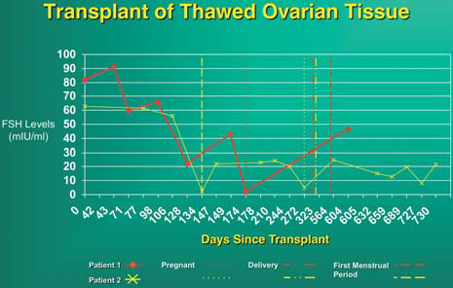
Ovarian Tissue Cryopreservation
All transplants (fresh & frozen) had a return of ovulatory menstrual cycles within 4 months.
The duration of function was 6 years for the fresh and less than 2 years for the slow frozen grafts .
With the classical slow freeze technique, the in vitro viability testing
showed only 41% of oocytes survived
(Newton et al., 1996; Gook et al., 1999; Kagawa et al., 2009; Silber et al., 2010).
However, with vitrification of the ovarian tissue there was no difference between fresh unfrozen controls and frozen tissue.
(S.J. Silber , Molecular Human Reproduction, Vol.18, No.2, 2012)
It seems likely, therefore, that vitrified ovarian tissue would give better results after transplantation than tissue cryopreserved by slow freeze, but it is too early to state that with any certainty.
Recovery of ovarian function after fresh cortical tissue transplant
Recovery of ovarian function after thawed cortical tissue transplant
S.J. Silber. Ovary cryopreservation and transplantation for fertility preservation. Molecular Human Reproduction, Vol.18, No.2 pp. 59–67, 2012
Notes:
It is clear from our fresh
grafts that with a proper micro-surgical technique, ischemia time is
not a problem for cortical grafting. The only issue remaining is what
is the optimal method of cryopreservation?

Slide 30
Conclusion
  Vitrification will it replace conventional freezing techniques?
  Recent published data of the vitrification of human oocytes, embryos and ovarian cortical tissue indicate that vitrification works and produces better results than conventional slow freezing and it will eventually replace it.

Slide 31

Thank You

