Slide 1
ABC of Subfertility
Yasser Orief M.D.
Lecturer of Obstetrics & Gynecology, Alexandria University
Fellow, Lϋbeck University, Germany
DGOL, Auvergné University, France

Slide 2
Definitions

Slide 3
Chance of spontaneous conception
Fecundability is the probability of achieving a pregnancy within one menstrual cycle (about 25% in normal couples)
Fecundity is the ability to achieve a live birth within one menstrual cycle.

Slide 4
Conception is most likely to occur in the first month of trying (about a 30% conception rate).
The chance then falls steadily to about 5% by the end of the first year.
Cumulative conception rates are around 75% after six months, 90% after a year, and 95% at two years.

Slide 7
The likelihood of spontaneous conception is affected by
age,
previous pregnancy,
duration of subfertility,
timing ofintercourse during the natural cycle,
extremes of body mass,
and pathology present.

Slide 8
Infertility is defined as one year of unprotected coitus without conception. It affects approximately 10–15% of couples in the reproductive age group.
Primary subfertility: a delay for a couple who have had no previous pregnancies
Secondary subfertility: a delay for a couple who have conceived previously, although the pregancy may not have been successful (for example, miscarriage, ectopic pregnancy)

Slide 9
Factors affecting fertility
Increased chance of conception
x Woman aged under 30 years
x Previous pregnancy
x Less than three years trying to conceive
x Intercourse occurring during six days before ovulation, particularly two days before ovulation
x Woman’s body mass index (BMI) 20-30
x Both partners non-smokers
x Caffeine intake less than two cups of coffee daily
x No use of recreational drugs

Slide 10
Reduced chance of conception
x Women aged over 35 years
x No previous pregnancy
x More than three years trying to conceive
x Intercourse incorrectly timed, not occurring within six days before ovulation
x Woman’s BMI < 20 or > 30
x One or both partners smoke
x Caffeine intake more than two cups of coffee daily
x Regular use of recreational drugs
Notes:
Age: The reduction in fertility is greatest in women in their late 30s and early 40s. For women aged 35-39 years the
chance of conceiving spontaneously is about half that of women aged 19-26 years. The natural cumulative conception rate in the
35-39 age group is around 60% at one year and 85% at two years.
If the duration of subfertility is less than three years, a couple is 1.7 times more likely to conceive than couples who have been trying for longer.
With unexplained subfertility of more than three years, the chances of conception occurring are about 1-3% each cycle.
Previous pregnancy: The likelihood of conception is increased 1.8-fold if the couple has secondary rather than primary subfertility.
Obesity : (body mass index (BMI) (weight (kg)/(height (m)2) < 20 or > 30
is also associated with an increased risk of miscarriage and obstetric complications such as hypertension, gestational diabetes, thromboembolism, and complicated delivery
It has been estimated that smokers are 3.4 times more likely to take more than a year to conceive than non-smokers, and in each cycle smokers have two thirds the chance of conceiving compared with non-smokers
Timing of intercourse during ovulatory cycle The window of opportunity lasts six days, ending on the day of ovulation. the probability of
conception rose from six days before ovulation, peaked two days before ovulation, then fell markedly by the day of ovulation. This is consistent with the progesterone induced changes in cervical mucus that occur immediately after ovulation and impede the penetration of sperm.
Impaired fertility in women drinking more than five units of alcohol a week, whereas others have found that low to moderate alcohol
consumption may be associated with a higher conception rate than in non-drinkers. Excess alcohol consumption in men can
contribute to impotence and difficulties with ejaculation and may impair spermatogenesis.

Slide 11
Epidemiology

Slide 12
Is subfertility getting more common?
Changing roles and aspirations for women.
Postponement of marriage.
Delayed age of childbearing.
Increasing use of contraception.
Liberalized abortion.
Concern over the environment. (Oestrogenic pollutants)
Unfavorable economic conditions.

Slide 13
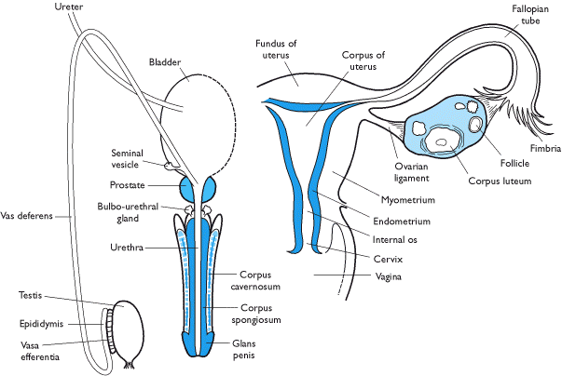
Causes ?
Male
Female
Combined
Notes:
The major causes of subfertility can be grouped broadly as ovulation disorders, male factors (which include disorders of
spermatogenesis or obstruction), tubal damage, unexplained, and other causes, such as endometriosis and fibroids. The
proportion of each type of subfertility varies in different studies and in different populations. Tubal infertility is more common
in those with secondary subfertility and in populations with a higher prevalence of sexually acquired infections.

Slide 14
The impact of subfertility
Many find it stressful to seek professional help for such an intimate problem and feel a sense of failure at having to do so.
It is not uncommon for the problem to put a strain on the relationship and many couples experience a deterioration in their sexual relationship which exacerbates the problem.

Slide 15
Preconception advice
Pre-existing medical problems
Stabilise medical conditions and ensure that medical control is optimal
Check that drugs needed are safe for use in pregnancy and do not affect sperm function
Where appropriate, refer woman to an obstetric physician for advice on implications of the condition in pregnancy
Weight
Check BMI
Advise on weight gain or loss where BMI is < 20 or > 30
Smoking
Advise both partners to stop smoking

Slide 16
Preconception advice
Recreational drugs
Advise both partners to stop using recreational drugs
Folic acid
Women who are trying to conceive should take folic acid supplements (0.4 mg) daily to reduce the risk of neural tube defects.
Women with a history of neural tube defect or epilepsy should take
5 mg daily
Virology screening
Screen for rubella immunity and offer immunisation to those not
immune
Consider screening for HIV and hepatitis B and C in groups at risk

Slide 17
Preconception advice
Prenatal diagnosis
Tell older women about options for prenatal diagnosis
Timing of intercourse
Check couple’s understanding of ovulatory cycle and relate most
fertile days to the length of woman’s cycle
Advise that intercourse occurs regularly. Two to three times a week
should cover the most fertile time
Factors affecting fertility
Discuss any factors in either partner’s history that might warrant
early referral for specialist infertility advice

Slide 18
Making a diagnosis

Slide 19
Investigations: who and when
Factors that may warrant early referral or investigation (before a year)
Female
Age > 35 years
Previous ectopic pregnancy
Known tubal disease or history of pelvic inflammatory disease or sexually transmitted disease
Tubal or pelvic surgery
Amenorrhoea or oligomenorrhoea
Presence of substantial fibroids

Slide 20
Investigations: who and when
Male
Testicular maldescent or orchidopexy
Chemotherapy or radiotherapy
Previous urogenital surgery
History of sexually transmitted disease
Varicocele

Slide 21
A rational approach to investigation
Initial investigations should be completed within three to four months and should establish the following points.
Does the woman ovulate?
If not, then why not?
Is the semen quality normal?
Is there tubal damage or uterine abnormality?
Both partners must be investigated.

Slide 22
Initial investigations that can be done in primary care
Female
LH, FSH and E2 concentrations—should be measured in early follicular phase (days 2 to 6)
P4 test—should be done mid-luteal phase (day 21 or seven days before expected menses)
TSH, PRL, testosterone test—should be done if woman’s cycle is irregular, shortened, or prolonged or if progesterone indicates anovulation

Slide 23
Initial investigations that can be done in primary care
Rubella serology test: should be checked even if the woman has been immunised in past
Cervical smear: should be carried out as normal screening protocol
Transvaginal ultrasound scan: should be done if there is the possibility of polycystic ovaries or fibroids
Male
Semen sample for analysis—sample should be taken after two or
three days’ abstinence and repeated after six weeks if abnormal.
The postcoital test is unreliable and is no longer recommended.

Slide 24
Completing investigations in secondary care
Female
Assess tubal status and uterine cavity
HSG
HyCoSy
Laparoscopy and dye test with hysteroscopy
Tests for tubal patency should take place in the first 10 days of a cycle to avoid the possibility, however unlikely, of disrupting an early spontaneous pregnancy.
Unless cervical screening for chlamydia has been performed, prophylactic antibiotics such as doxycycline and metronidazole should be given

Slide 25
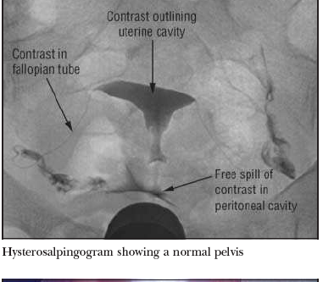

Slide 26
Notes:
HyCoSy gives extra information because an
ultrasound scan of the pelvis is performed at the same time,
allowing the detection of fibroids or polycystic ovaries.

Slide 28
Completing investigations in secondary care
Male
If azoospermia is present
FSH, luteinising hormone, and testosterone (with or without prolactin, thyroid stimulating hormone) tests
Cystic fibrosis screening and karyotype if < 5 × 106/ml
Centrifugation of ejaculate and examination of pellet for spermatozoa
Testicular biopsy or exploration

Slide 29
Completing investigations in secondary care
Male
If oligozoospermia and signs of hypogonadotrophic hypgonadism
FSH, luteinising hormone, prolactin thyroid stimulating hormone,and testosterone test

Slide 30
Further investigation of azoospermia in secondary care
Notes:
If azoospermia is confirmed it is important to distinguish
between obstructive and non-obstructive azoospermia.
In obstructive azoospermia, spermatogenesis is normal but
there is a block in the epididymis or vas deferens. If congenital
absence of vas deferens is suspected, both partners should
undergo cystic fibrosis screening because many of these men
will carry one of the cystic fibrosis mutations.
In non-obstructiveazoospermia, spermatogenesis is impaired. This impairment
may be caused by testicular failure (so the man’s karyotype
should be checked and multiple testicular biopsy may show
isolated foci of spermatogenesis) or due to a failure to stimulate
spermatogenesis by the hypothalamic pituitary axis
(hypogonadotrophic hypogonadism). Although rare, this
condition should be detected as these patients respond to
gonadotrophin treatment.

Slide 31
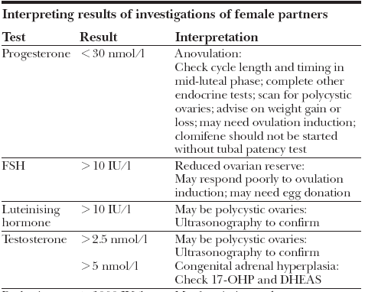
Interpreting results and discussing treatment options

Slide 32
Interpreting results and discussing treatment options

Slide 33
Interpreting results and discussing treatment options

Slide 34
Anovulation

Slide 35
CNS-Hypothalamus-Pituitary
Ovary-uterus Interaction
Neural control
Chemical control
Dopamine
(-)
Norepiniphrine
(+)
Endorphines
(-)
Hypothalamus
Gn-RH
±
?
–
Ant. pituitary
FSH, LH
Estrogen
Ovaries
Progesterone
Uterus
Menses

Slide 36
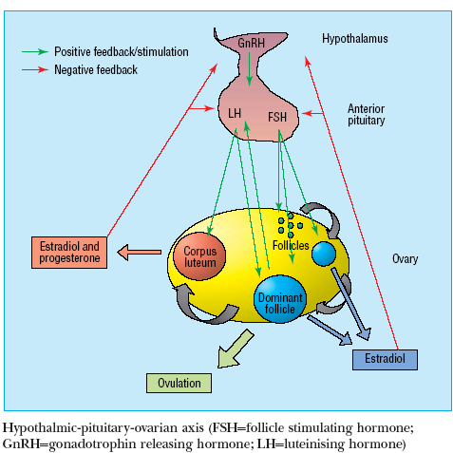
Notes:
Disorders of ovulation account for about 30% of infertility and
often present with irregular periods (oligomenorrhoea) or an
absence of periods (amenorrhoea).
not
all causes of anovulation are amenable to treatment by
ovulation induction. Anovulation can sometimes be treated with
medical or surgical induction, but it is the cause of the
anovulation that will determine whether ovulation induction is
possible.

Slide 37
Notes:
Hypothalamic-pituitary causes
Hypogonadotrophic hypogonadism is characterised by a
selective failure of the pituitary gland to produce luteinising
hormone and follicle stimulating hormone. The commonest
cause is excessive exercise, being underweight, or both.Women
who have a low body mass index (weight (kg)/(height (m)2)) (for
example, < 20) or who exercise excessively—for example,
gymnasts, marathon runners, ballerinas—may develop
amenorrhoea because of a physiological reduction in the
hypothalamic production of gonadotrophin releasing hormone.
Women who are underweight for their height when they get
pregnant are more likely to have “small for dates” babies; and
children of women who have eating disorders are more likely to
be admitted to hospital with failure to thrive.
Sheehan’s syndrome (panhypopituitarism), caused by
infarction of the anterior pituitary venous complex (usually
after massive postpartum haemorrhage or trauma), and
Kallman’s syndrome (amenorrhoea with anosmia caused by
congenital lack of hypothalamic production of gonadotrophin
releasing hormone) are rare. Children treated for a
craniopharyngioma or some forms of leukaemia may have
hypogonadotrophic hypogonadism secondary to cerebral
irradiation, which may affect the hypothalamus or the pituitary.
Hyperprolactinaemia is usually caused by a pituitary
microadenoma. This leads to a reduction in the production of
pituitary luteinising hormone and follicle stimulating hormone.
Although the commonest presentation is secondary
amenorrhoea, some women may present with galactorrhoea. A
smaller number may have headaches or disturbed vision that
may indicate a macroadenoma, which needs urgent
investigation and treatment. A microadenoma is easily treated
with drugs with a subsequent resumption of menses and
fertility.
Ovarian causes
Polycystic ovary syndrome is the commonest cause (70%) of
anovulatory subfertility. The primary abnormality seems to be
an excess of androgen production within the ovary that leads to
the recruitment of large numbers of small preovulatory follicles,
which fail to respond to normal concentrations of follicle
stimulating hormone. Thus, a dominant follicle is rarely
produced.Women with polycystic ovary syndrome commonly
present in their late teens or early 20s with hirsutism, acne,
orirregular periods (cycle length > 35 days). Even if they ovulate,
the chance of conception for these women is reduced because
fewer ovulatory events occur in a given time frame. Only a third
of women with polycystic ovary syndrome are obese, but obesity
increases the likelihood of a woman with the syndrome
developing anovulation.

Slide 39
Notes:
Causes unsuitable for ovulation
induction
Premature ovarian failure (premature menopause)
Unfortunately this is an irreversible condition. The only
treatment option that can result in conception is the use of
donated eggs with in vitro fertilisation. Patients will need
hormone replacement therapy to alleviate menopause
symptoms and to reduce loss of bone density (see
www.daisynetwork.org.uk).
Genetic abnormalities
The commonest genetic abnormality is Turner’s syndrome
(45,X), in which underdeveloped (streak) ovaries result in
primary ovarian failure (premature menopause). With adequate
oestrogen replacement the uterus can grow large enough for
the woman to conceive using donated eggs with in vitro
fertilisation. Some translocations and deletions of the X
chromosome also cause ovarian failure. Information about
Turner’s syndrome can be found on the Turner Syndrome
Support Society’s website at www.tss.org.uk
Ten per cent of primary amenorrhoea is caused by
androgen insensitivity syndrome (formerly testicular
feminisation). These women have a 46,XY karyotype and
intra-abdominal gonads that are testes but have developed as
phenotypically female because of the absence of, or
non-functionality of androgen receptors. The vagina usually
ends blindly and, as there is no uterus, pregnancy is impossible.
The gonads should be removed because of an increased risk of
malignant change. Explaining the nature of the problem to the
patient needs care and sensitivity, and longer term
psychological support may be needed.

Slide 40
Notes:
Diagnosis of anovulatory subfertility
Hypogonadotrophic hypogonadism
Regardless of the underlying cause, the concentrations of
luteinising hormone, follicle stimulating hormone, and estradiol
will be low. A careful history (surgery, radiotherapy, massive
haemorrhage, lack of smell, exercise, and eating habits) and a
body mass index measurement will reveal the cause.
Hyperprolactinaemia
A serum prolactin concentration of > 1000 IU/l is diagnostic
and usually indicates a microadenoma. Magnetic resonance
imaging or computed tomography should be arranged to
detect whether a macroadenoma is present. Patients with a
macroadenoma must have their visual fields checked. The
luteinising hormone and follicle stimulating hormone
concentrations are usually at the lower end of the normal range
with a low estradiol concentration.
Polycystic ovary syndrome
A transvaginal ultrasound scan of the pelvis will confirm the
diagnosis. In 80% of women with polycystic ovary syndrome the
testosterone concentration will exceed the normal upper limit
of 2.4 nmol/l, making this a sensitive and specific endocrine test
for this condition. Luteinising hormone concentrations are
raised ( > 10 IU/l) in 45-70% of women with the syndrome.

Slide 43
Management of anovulation
Notes:
Treating specific causes
Change of weight
Women with polycystic ovary syndrome who are overweight
(body mass index > 30) should be advised to lose weight.
Together with exercise, weight loss (even as little as 5% of body
mass) reduces insulin and free testosterone levels, resulting in
improved menstrual regularity, ovulation, and pregnancy rates.
If a woman is obese when she is pregnant she is more likely to
miscarry.Women who are underweight (body mass index < 20)
should be encouraged to gain weight, and no infertility
treatment should be offered until their body mass has returned
to the lower limits of normal.
Hyperprolactinaemia
Bromocriptine is safe and commonly used. Treatment should
start with a dose of 1.25 mg (taken with food) at night for the
first fortnight and then increased to 2.5 mg for another
fortnight. The prolactin level should be checked, and if the level
is below 1000 IU/l, the dose should be maintained. The side
effects of bromocriptine (postural hypotension, nausea, vertigo,
headache) can make it unacceptable to the patient. Cabergoline
and quinagolide are newer long acting dopamine agonists with
fewer side effects. Once prolactin levels have returned to below
1000 IU/l the woman’s periods should return and 70-80% of
women will ovulate.
Hypothyroidism
In hypothyroidism thyrotropin releasing hormone may
stimulate prolactin secretion in addition to thyrotropin
releasing hormone from the anterior pituitary. Correction of
the hypothyroidism with thyroxine replacement allows thyroid
stimulating hormone and prolactin levels to return to normal,
releasing the suppression to gonadotrophin secretion and
ovulation.

Slide 44
Notes:
Medical induction
Pulsatile gonadotrophin releasing hormone
Treatment with gonadotrophin releasing hormone that is
started in a specialised hospital setting may be suitable for
women who have a purely hypothalamic cause for their
amenorrhoea, for example women with recovered weight
related amenorrhoea but who are still not ovulating. The
woman wears a small mechanical syringe pump that can deliver
a pulse of gonadotrophin releasing hormone subcutaneously
every 90 minutes, and this usually leads to unifollicular
ovulation. Local reactions may occur at the injection site.
Conception rates are similar to those in the normal population
at around 20-30% per cycle and 80-90% after 12 months’ use.
Antioestrogen treatment: Clomifene
Clomifene acts by blocking oestrogen receptors in the pituitary
leading to an increased production of follicle stimulating
hormone, which then stimulates development of one or more
dominant follicles. These drugs can be used only in conditions
in which the hypothalamic-pituitary axis is functioning—for
example, polycystic ovary syndrome. Ovulation induction with
clomifene should be undertaken only in circumstances that
allow access to ovarian ultrasound monitoring, because of the
risk of multiple follicle development and the small but real risk
of ovarian hyperstimulation syndrome (Royal College of
Obstetricans and Gynaecologists’ guidelines, No 3). Seventy per
cent of women with polycystic ovary syndrome will ovulate in
response to clomifene, with a conception rate of 40-60% at six
months. The incidence of twins is around 10%, and triplets 1%.
Metformin
Increasingly, studies report that metformin at doses of
1500 mg a day (in a similar way to weight loss) may improve
menstrual regularity by reducing insulin and free testosterone
concentrations in both lean and obese women with polycystic
ovary syndrome who are not ovulating. However, caution is
needed because metformin is not licensed for this indication,
and the results of convincing trials are still awaited.
Follicle stimulating hormone injections
Treatment with follicle stimulating hormone is used in women
with hypothalamic-pituitary causes of anovulation, and for
women with polycystic ovary syndrome who have failed to
respond to or conceive using clomifene. As the most serious
complications of this therapy are ovarian hyperstimulation
syndrome and high order multiple pregnancy, it is essential that
this treatment is monitored by reproductive specialists with
access to ultrasonography and tertiary care facilities.

Slide 45
Notes:
Surgical induction
Laparoscopic ovarian diathermy or “drilling” has replaced
wedge resection of the ovaries in women with polycystic ovary
syndrome. At laparoscopy, five to six diathermy or laser
punctures are made in the ovary. Success rates are comparable
with follicle stimulating hormone administration, with lower
risks of multiple pregnancy or ovarian hyperstimulation
syndrome, but complications can arise from surgery and
adhesion formation. If too much ovarian tissue is destroyed
there is a potential risk of premature ovarian failure in the
future, although this risk is still being evaluated.

Slide 47
Tubal subfertility

Slide 48
Patent fallopian tubes are a prerequisite for normal human fertility. However, patency alone is not enough, normal function is crucial. Although patients often view them as either open or “blocked,” the fallopian tubes are highly specialized organs.
A fallopian tube obstruction occurs in 12% to 33% of infertile couples,1 and so tubal patency should be investigated early.

Slide 49
Causes of tubal damage
Infection
Chlamydia trachomatis
Gonorrhea
Genital tuberculosis
Post pregnancy sepsis
IUDs
Endometriosis
Surgery
Complications after surgery
Sterilization
Notes:
Chlamydia trachomatis
Chlamydia trachomatis accounts for around half the cases of
acute pelvic inflammatory disease in developed countries. It
is the commonest sexually transmitted agent in the United
Kingdom. Chlamydial infections are often not diagnosed
because they are usually asymptomatic or have few signs of
infection. Both symptomatic and asymptomatic chlamydial
infections can damage the reproductive tract. In women, they
can cause urethritis, cervicitis, endometritis, and salpingitis,
which may result in peritubal adhesions. These adhesions may
cause subfertility, ectopic pregnancy, and chronic pelvic pain.
Delayed treatment increases the risk of these sequelae and
transmission of the infection to sexual partners.
Gonorrhoea
Gonorrhoea is particularly common in young, urban women
of low socioeconomic groups and in people who have several
sexual partners. It may present as a localised infection of the
lower genital tract, as an invasive infection of the upper genital
tract, or as disseminated disease with systemic manifestations;
however, it may be asymptomatic. Infection with chlamydia is
concurrent in 30-50% of patients from whom gonococcus is
isolated.
Genital tuberculosis
Genital tuberculosis can cause simple tubal block, tubo-ovarian
abscesses, or dense pelvic adhesions (frozen pelvis).
Post-pregnancy sepsis
Post-pregnancy sepsis (post-abortion and puerperal infection)
may be associated with salpingitis and endometritis.
Endometritis with retained products of pregnancy followed by
vigorous curettage can result in denudation of the
endometrium; intrauterine adhesions (synechiae) can form,
which may wholly or partially occlude the uterine cavity. This is
an unusual, but important, cause of infertility (Asherman’s
syndrome), and the patient generally presents with
oligomenorrhoea or amenorrhoea, although the hormone
profile of the patient is normal.
Intrauterine contraceptive devices
Upper genital tract infection associated with intrauterine
contraceptive devices is temporally linked to the insertion of the
device. Increased risk occurs in the first 20 days after insertion.
Beyond the first month after insertion the risk of upper genital
tract infection is small. The risk of infertility after the use of an
intrauterine contraceptive device is stopped is not increased,
nor is fertility impaired even when the device is removed
(usually because of complications, such as menorrhagia).
Endometriosis
Complete tubal occlusion is rarely caused by pelvic
endometriosis. Tubal distortion and limitation of fimbrial
mobility caused by the associated pelvic adhesions is more
likely.

Slide 53
Notes:
Surgery
Complications after surgery
Previous laparotomy is a recognised risk factor for tubal
subfertility, but a history of perforated appendix in childhood
does not seem to have a long term negative effect on female
fertility.
Sterilisation
People who change their mind after tubal interruption and wish
to conceive can have surgical reconstruction of the fallopian
tubes or in vitro fertilisation. The results of surgical reversal will
depend on the method used to perform the sterilisation (clips,
rings, diathermy, or excision), the site of sterilisation, the length
of tube remaining, and ovulatory and sperm factor.

Slide 54
Prevention of tubal damage
Practising safe sex is important in reducing sexually transmitted diseases and their sequelae.
Screening women of reproductive age for chlamydial infection has been shown to reduce its prevalence and the incidence of PID.
Aggressive treatment of suspected PID reduces late sequelae.

Slide 55
Prevention of tubal damage
The sexual partners of patients must be treated rapidly to decrease the risk of reinfection.
The management of women undergoing induced abortion should include a strategy for minimising the risk of post-abortion PID.

Slide 56
Prevention of tubal damage
Women undergoing invasive uterine procedures (hysteroscopy, hycosy, and HSG) should be screened for chlamydia or receive prophylactic antibiotics.

Slide 58
Diagnosis of tubal factor
Infection screening
Hysterosalpingo-contrast sonography
Hysterosalpingography
Laparoscopy and dye hydrotubation test
Notes:
Diagnosis of tubal subfertility
Infection screening
Chlamydia antibody testing is a simple and cheap screening test
for the likelihood of tubal subfertility. The predictive value of
testing will depend on the cut-off level of the immunoglobulin G
titre chosen and the criteria applied for tubal factor subfertility.
Recent studies concluded that the optimum cut-off titre should
be 16 because it gives the best combination of sensitivity and
specificity.However, high titres of chlamydial antibodies in
infertile women indicate the need for early laparoscopy to assess
tubal status.
Hysterosalpingo-contrast sonography
Hysterosalpingo-contrast sonography is a simple outpatient
procedure using ultrasonography. An echocontrast fluid is
introduced into the uterine cavity via a 5 French cervical
balloon catheter so that the uterine cavity, ovaries, and fallopian
tube patency can be assessed accurately. The use of transvaginal
ultrasonography avoids exposure to x rays and is particularly
suitable as a diagnostic test in patients with a low likelihood of
tubal disease. Finding a normal cavity and bilateral fill and spill
of contrast is reassuring, but where there is doubt,
hysterosalpingography or a laparoscopy and dye hydrotubation
test should be done. Transvaginal ultrasonography can
sometimes be useful in detecting hydrosalpinges.
Hysterosalpingography
Hysterosalpingography is a simple, safe, and inexpensive x ray
based contrast study of the uterine cavity and the fallopian
tubes with a 65% sensitivity and 83% specificity for detecting
tubal blockage.
Proximal tubal occlusion can be associated with mild
peritoneal endometriosis. The mechanism is unclear, but the
occlusion is thought to be caused by a combination of the
deposition of intraluminal debris from retrograde menstruation
and raised tubal perfusion pressure.4
Distal tubal blockage, which is commonly caused by pelvic
inflammatory disease, is usually associated with distension of
the ampullary portion of the fallopian tube (hydrosalpinges)
and variable degree of loss of the internal mucosal folds.
Laparoscopy and dye hydrotubation test
A laparoscopy and dye hydrotubation (“lap and dye”) test is the
most reliable, albeit expensive, tool used to diagnose tubal
subfertility. It is usually performed as a day case surgical
procedure under general anaesthesia. When there is no prior
information about the uterine cavity, the test can be combined
with hysteroscopy for maximum information. Morphological
abnormalities of the fallopian tubes can be seen directly, and
the general pelvic appearance may give some clue as to the
likely cause of any abnormalities found. When comparing
hysterosalpingography with laparoscopy, keep in mind that
both procedures provide more information than on the
condition of the fallopian tubes alone. Hysterosalpingography
provides information about the status of the uterine cavity,
whereas laparoscopy allows inspection of the intra-abdominal
cavity, excludes peritoneal disease, and allows laparoscopic
surgery. The latter has become especially important because it
was recently shown that laparoscopic treatment of early
endometriosis improves fertility prospects by 13% over the
next nine months.

Slide 66
Male subfertility

Slide 71
Clinical Assessment

Slide 74
Treatment options for subfertile men
What doesn’t work
Abstaining from coitus until ovulation does not improve the semen or likelihood of conception. Increasing coital frequency (alternate days) supplies more viable spermatozoa that normally remain motile in the female tract for two to three days

Slide 75
Treatment options for subfertile men
Treatment with gonadotrophin injections, androgens (mesterolone) or antioestrogens (clomifene or tamoxifen) is not indicated because although they may improve the sperm count, fertility rates are not improved as the spermatozoa remain dysfunctional

Slide 76
Drugs that can impair male fertility
Impaired spermatogenesis: Sulfasalazine, methotrexate, nitrofurantoin, colchicine, chemotherapy
Pituitary suppression: Testosterone injections, gonadotrophin releasing hormone analogues
Antiandrogenic effects: Cimetidine, spironolactone
Ejaculation failure: blockers, antidepressants, phenothiazines
Erectile dysfunction: blockers, thiazide diuretics, metoclopramide
Drugs of misuse: Anabolic steroids, cannabis, heroin, cocaine

Slide 77
Conservative measures for men with suboptimal semen analyses
Stop smoking—Nicotine reduces seminal plasma antioxidants
Have frequent intercourse—Increases output of non-senile spermatozoa
Reduce alcohol intake—Alcohol can suppress spermatogenesis
Wear boxer shorts and avoid hot baths—Heat suppresses spermatogenesis
Avoid pesticides, herbicides, heat, and radiation at work—All impair spermatogenesis

Slide 80
Unexplained infertility,
endometriosis, and fibroids

Slide 81
Unexplained infertility
A diagnosis of unexplained fertility can be highly frustrating for patients, who may interpret this as meaning that there is apparently “no cause” for their subfertility and hence no effective treatment

Slide 83
Should further tests be done?

Slide 84
Treatment options
“Expectant” management
Superovulation and intrauterine insemination

Slide 86
Endometriosis

Slide 90
Fibroids

Slide 96
Assisted conception
General principles

Slide 97
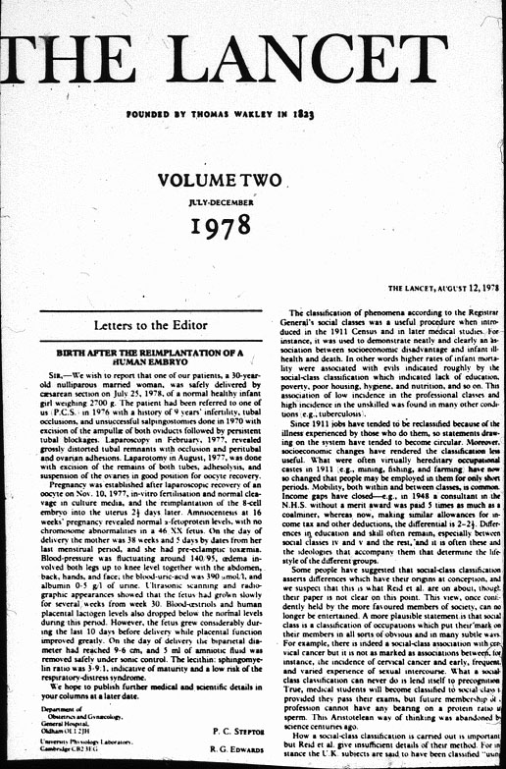
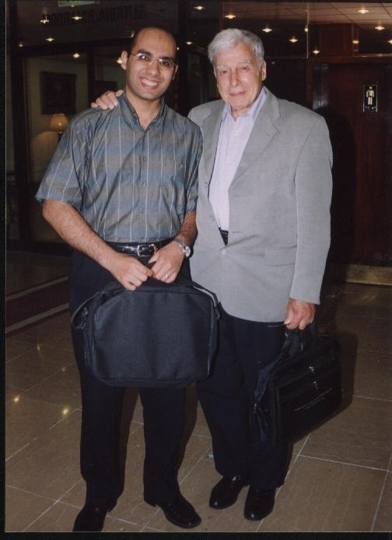

Slide 99
Superovulation

Slide 102
Intrauterine Insemination

Slide 103
Sperm preparation
Notes:
Preparation of sperm for assisted conception: motile sperm can be
successfully separated from seminal plasma using density gradients such as
Puresperm. Liquefied semen is carefully overlaid on the top of a density
gradient and gently centrifuged. Cellular debris, non-motile sperm, and
abnormal sperm are trapped at the interface. Motile sperm with normal
head morphology move to the bottom of the tube. This pellet is collected
and washed twice in fresh culture media. The final pellet is assessed and
used in treatment. Samples with low counts can be prepared in this way.
By increasing the centrifugal force, sufficient numbers of sperm can be
harvested for intracytoplasmic sperm injection

Slide 106
Gamete Intrafalopian Transfer
Notes:
First proposed in 1984, gamete intrafallopian transfer
may be seen by patients as more “natural” than in vitro
fertilisation, even though it requires laparoscopy and has
an increased risk of multiple pregnancy. Gamete
intrafallopian transfer is also deemed more acceptable in
some religious circles because fertilisation occurs within
the body rather than in a laboratory and surplus embryos
need not be created

Slide 108
In Vitro Fertilization
Notes:
Fertilisation: (left) each egg is surrounded by a complex of cumulus cells
(purple) that the sperm need to disperse to reach the zona pellucida, the
protective outer coating of the egg; (middle) capacitated sperm first bind to
the zona pellucida (1) and release enzymes from the acrosome (2), which
digest a pathway through the zona pellucida (3); (right) the sperm is able to
fuse with the plasma membrane of the egg and becomes incorporated
within the egg

Slide 112
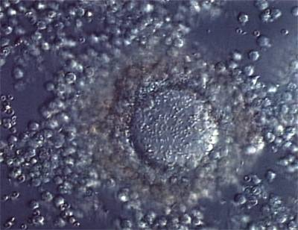

Slide 114
Intracytoplasmic Sperm Injection

Slide 116
 | IVF | ICSI
MALE
TUBAL
ENDOMETRIOSIS
CERVICAL
IMMUNOLOGIC
PCO
UNEXPLAINED
GENETIC
FAILED OR LOW FERTILIZATION IN IVF

Slide 117
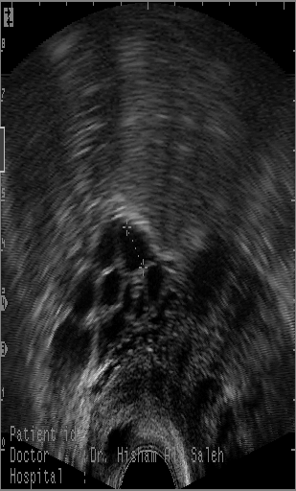
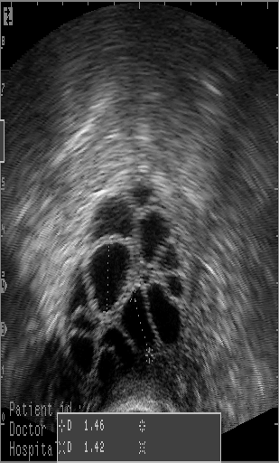
1. Controlled ovarian hyperstimulation

Slide 118
2. Oocyte retrieval (OR)

Slide 119
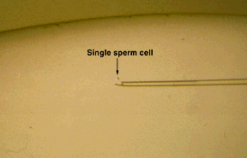
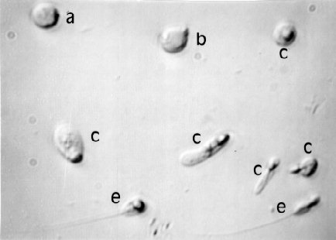
3. Sperm selection

Slide 120
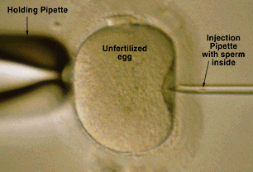
4. ICSI, fertilization, and cleavage

Slide 121
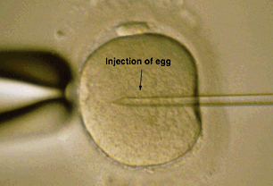
4. ICSI, fertilization, and cleavage

Slide 122
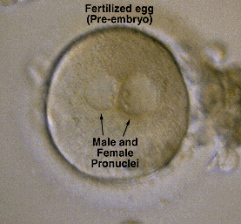
4. ICSI, fertilization, and cleavage

Slide 123
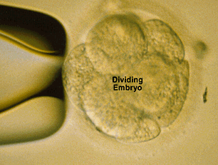
4. ICSI, fertilization, and cleavage

Slide 124
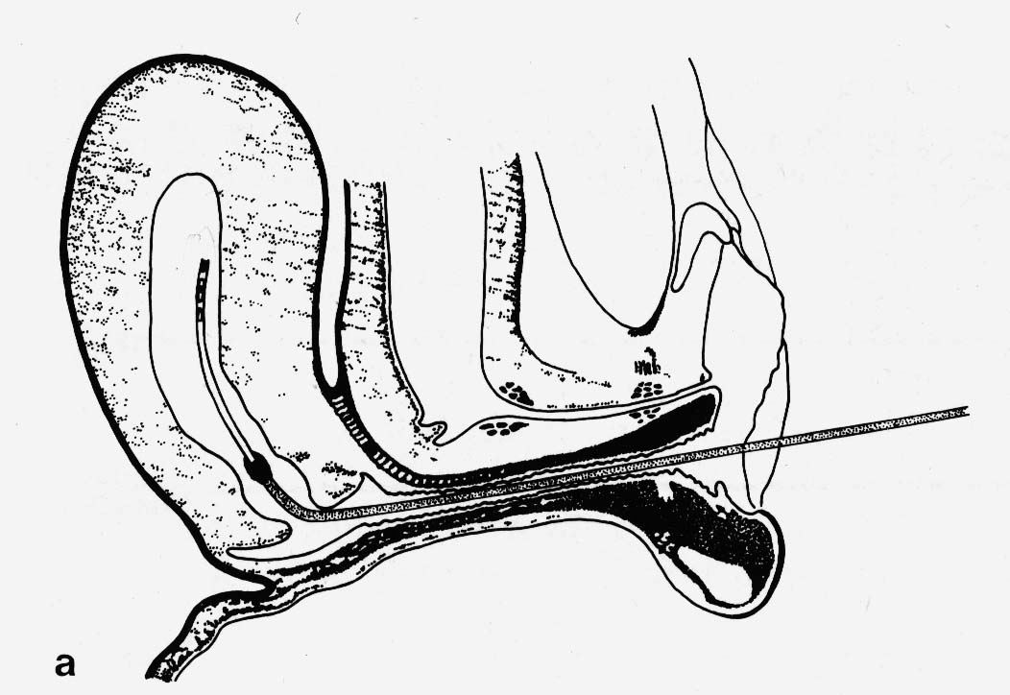
5. Embryo transfer

Slide 126
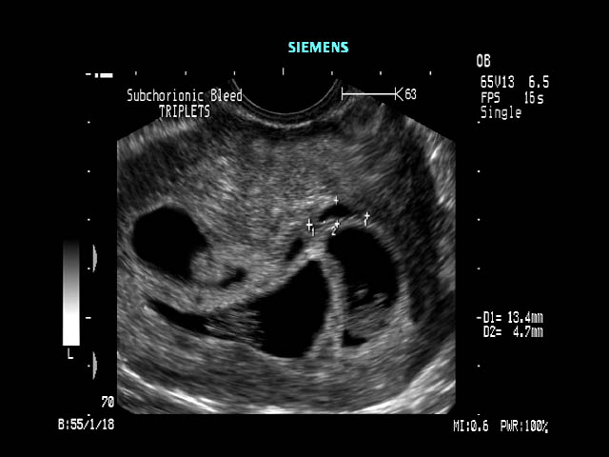
6. Detection of pregnancy.

Slide 127
Success of IVF and ICSI

Slide 128
Problems with
assisted conception

Slide 129
Ovarian Hyperstimulation
syndrome

Slide 130
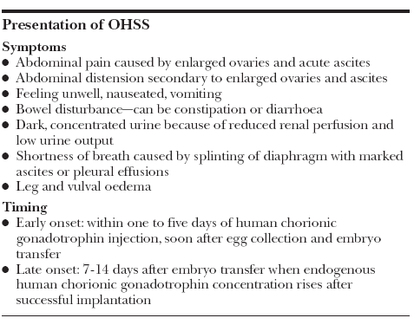

Slide 132
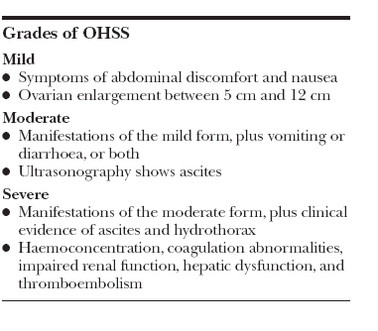

Slide 134
Ectopic pregnancy

Slide 135
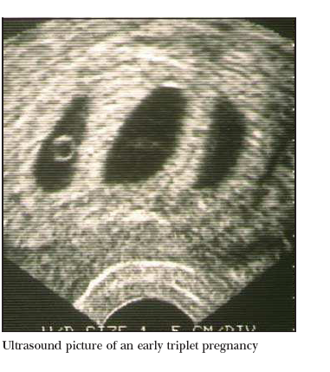
Multiple Pregnancy

Slide 136
Creation of surplus embryos

Slide 138
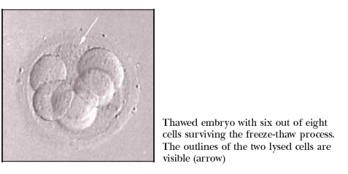

Slide 139
Sperm Cryopreservation

Slide 140
Further advances
and uses of
assisted conception technology

Slide 141
Preserving fertility for young women
Cryopreservation of oocytes
A major challenge in the cryopreservation of oocytes is to
(a) preserve the egg’s ability to be fertilised and
(b) maintain the integrity of its genetic material so that amgenetically normal embryo is produced

Slide 144
Cryopreservation of ovarian tissue and maturation of oocytes and follicles in vitro
Autografting
In vitro maturation

Slide 145
Preserving fertility in prepubertal boys

Slide 146
Preimplantation genetic diagnosis
Notes:
The principle of preimplantation genetic diagnosis. A single blastomere is
removed from each 8-cell human embryo for the purposes of
preimplantation genetic diagnosis. Up to two embryos found to be
unaffected by the genetic disorder are transferred to the uterus

Slide 148
Preimplantation screening of embryos

Slide 149
Notes:
Aneuploidy screening—normal embryos are diploid and have two spots for
each colour (A). Many different abnormalities have been seen; some are
shown above. The complete set of chromosomes has been duplicated in
triploid (B) and tetraploid (C) nuclei. A set of chromosomes is missing in
haploid embryos (D). Abnormalities of individual chromosomes are also
seen (E), such as monosomy, trisomy, and double trisomy (F). If embryos with
such abnormalities could be screened out, a higher implantation rate might
be achieved after in vitro fertilisation

Slide 150
Stem cells and therapeutic cloning

Slide 219
THANK YOU FOR YOUR ATTENTION

