Slide 2
Endometriosis
Yasser Orief M.D.
Fellow Lübeck University , Germany.
DAGO, Auvergné University, France.

Slide 3
Learning Objectives
Identify the symptoms and consequences
associated with endometriosis
Describe various treatment options in the
management of endometriosis

Slide 4
Definition
Endometriosis is a disease in which endometrial glands and stroma implant can grow in areas outside the uterus
Most commonly implants are found in the pelvis
Lesions may occur at distant sites: pleural cavity, liver, kidney, gluteal muscles, bladder, etc
Notes:
Medical definition:
Endometriosis is endometrium including both endometrial glands and stroma in an ectopic location (Albee, 1997)
endometriosis occurs when the same type of tissue that makes up the endometrial lining of the uterus grows on other structures in the pelvis. These cells respond to fluctuations just like those in inside the uterus enlarging and multiplying as the ovaries produce estrogen and progesterone during the menstrual cycle (Garner, 1997).
endo=within, metri= uterus (womb), osis=condition
found in 12-15 % of women (5 million women in the US)
primarily found in women during their child-bearing years
common among adolescents
endometriosis is not cancer and there is no cure for it
one of the most common diseases but it is also one of the least understood

Slide 5
Endometrial tissue
Responds to estrogen and progesterone
Endometrial tissue is found living outside the uterus
If no pregnancy occurs the endometrial lining is shed, the endometrial tissue found outside the uterus breaks down as well causing internal bleeding
This internal bleeding is absorbed by the surrounding tissue
Over time, implanted tissues grow and form a build up of destructive scar tissue and adhesions
Collection of blood called a sac or cyst can form and rupture, causing excruciating pain

Slide 6
Where is it found in the body?
Usually endometriosis is found in the pelvic area
It has been found on every pelvic organ, including the uterus (17-55% of women), ovaries (61-78%), tubes, ligaments, uterers, bowel, bladder
However, it can be found in anywhere in the body
It has been found in the lungs, knees, nose, arms, brain

Slide 7
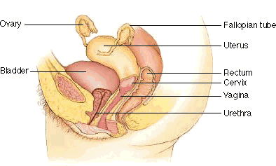
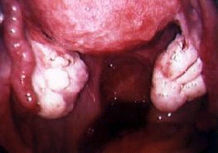
Commonly affected organs and structures: Ovaries and the sacral ligament

Slide 8
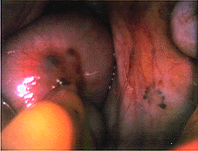
Endometriosis on bowel surfaces

Slide 9
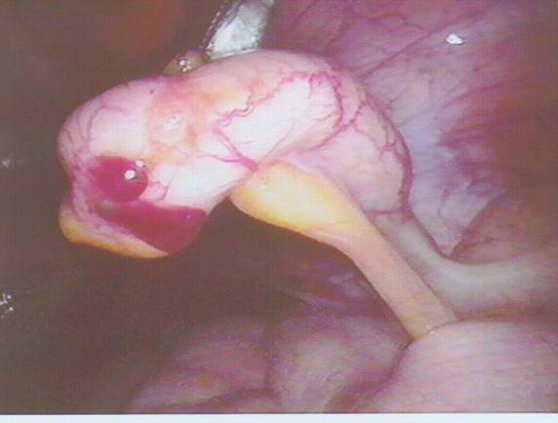
Endometriosis on appendix

Slide 10
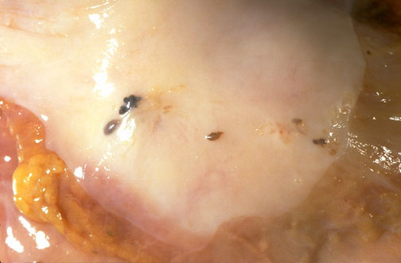
Notes:
Upon closer view, these five small areas of endometriosis have a reddish-brown to bluish appearance. Typical locations for endometriosis may include: ovaries, uterine ligaments, rectovaginal septum, pelvic peritoneum, and laparotomy scars. Endometriosis may even be found at more distant locations such as appendix and vagina.

Slide 11
Features of Endometriosis
Prevalence 2-50% of women; 21-47% of infertility cases
Exposure to ovarian hormones appears to be essential
No known racial or socioeconomic predilection
Severe disease may occur in families

Slide 12
Is Endometriosis Increasing?
1965-1984, endometriosis rose from 10 to 19% as primary indication for hysterectomy
Simultaneously, a trend of more conservative therapies was occurring, which suggests a true increase in the incidence
Theories
changing patterns of menstruation
women today have delayed childbirth until their 30s and 40s, meaning they have more periods, which leads to a greater chance for endometrial tissue to migrate through the fallopian tubes
greater awareness leads to more diagnosis
environmental toxin dioxin exposure is thought to increase endometriosis occurrences
Notes:
Are rates on the rise?
Causes: (Begany, 1997)
changing patterns of menstruation
women today have delayed childbirth until their 30s and 40s, meaning they have more periods, which leads to a greater chance for endometrial tissue to migrate through the fallopian tubes
greater awareness leads to more diagnosis
environmental toxin dioxin exposure is thought to increase endometriosis occurrences

Slide 13
Age at Diagnosis
> 45
< 19
36 –45
3%
6%
15%
19 – 25
24%
26 –35
52%

Slide 14
Etiology

Slide 15
Etiologies of Endometriosis
Sampson's theory: Retrograde menses and peritoneal implantation
Most women retrograde menstruate
Meyer's theory: Coelomic metaplasia
Low incidence of pleural disease
Halban's theory: Hematogenous or lymphatic spread to distant tissues
Does not explain gravity dependent disease sites
Notes:
retrograde menstruation (or transtubal migration theory)
theory of Dr. John Sampson
backward flow of menstrual fluid into the pelvic region instead of out the vagina
endometrial cells attach to ovaries or elsewhere in uterus
all women are thought to have some degree of retrograde menstruation
does not account for development of endo in arms, legs, or brain, where they have been discovered
studies have shown that women who have obstructions of the lower genital tract which might cause menstrual back up, such as vaginal or uterine infections, have higher rates of endometriosis (Mastro, 1996)
Endometrial cells migrate to the wrong location during the embryonic stage of fetal development then activate and grow during puberty
Endometrial cells moves through the blood vessels and lymphatic system and implants in various tissues of the body
A possible link between endo and exposure to dioxin
dioxin is an environmental toxin (Dioxin, 1993)
found in humans through pesticides in diet, or airborne dioxin released by certain types of waste incineration
found to increase endometriosis in rhesus monkeys
the higher the dose of dioxin, the more severe the monkey’s endometriosis

Slide 16
Etiologies of Endometriosis
Immune system changes
immune system deficiencies, unable to combat migrating endo tissue and destroy it
endometrial cells that are usually removed, are allowed to attach to tissues and grow
Genetics
could run in the family
a woman is ten times more likely to develop endometriosis if her mother or sister has it (Kashef, 1996)

Slide 17
Etiologies of Endometriosis
A possible link between endo and exposure to dioxin
dioxin is an environmental toxin (Dioxin, 1993)
found in humans through pesticides in diet, or airborne dioxin released by certain types of waste incineration
found to increase endometriosis in rhesus monkeys
the higher the dose of dioxin, the more severe the monkey’s endometriosis

Slide 18
Pathophysiology

Slide 19
Endometriosis Pathogenesis
Current clinical observations and research on endometriosis revealed a new concept on the pathogenesis of endometriosis
It seems that peritoneal, ovarian and recto-vaginal endometriosis are different forms of the disease
With the current knowledge and understanding of the disease, pathogenesis of endometriosis can be explained by a combination of possible causes rather than a certain theory

Slide 20
Current areas of research in the etiopathogenesis of endometriosis
Hormonal factors
Steroidogenesis
Genetics
Environmental Science
Immunology
Cancer Biology

Slide 21
Pelvic Endometriosis Prosposed Etiopathogenesis:
Environmental Factors
DIOXIN
Genetical Susceptibility
Retrograde Menstruation
Angiogenesis
VEGF
ENDOMETRIUM
E₂
IL8
MCP1
Aromatase
Immunological & Cellular Alterations

Slide 22
Pathology

Slide 23
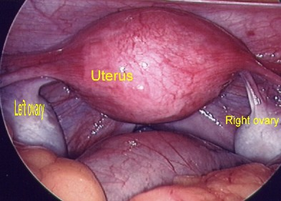
Normal Pelvic Structures

Slide 24
Appearance
Endometriosis May Appear
Typical
Brown
Black “Powder burn”
Atypical “Clear”
Endometriosis May Be Associated with Peritoneal Windows

Slide 25
Endometriosis

Slide 26
Endometriosis

Slide 27
Endometriosis

Slide 28
Endometriosis

Slide 29
Classification of Endometriosis
First stage
minimal disease --small amount of brownish, reddish, blue-black, white, or clear implants
Second stage
mild disease -- deeper and more numerous than stage one
Third stage
moderate disease -- many deep implants, small endometriomas on ovaries and some filmy adhesions
Fourth stage
severe disease -- many deep implants and dense adhesions, large endometriomas on ovaries, rectum may adhere to the back of the uterus

Slide 30
Classification of Endometriosis
I (Minimal)
Stage II (Mild)
4*
9
Stage III (Moderate)
Stage IV (Severe)
29
114
* Revised AFS Score
Notes:
First stage:
minimal disease --small amount of brownish, reddish, blue-black, white, or clear implants
Second stage:
mild disease -- deeper and more numerous than stage one
Third stage:
moderate disease -- many deep implants, small endometriomas on ovaries and some filmy adhesions
Fourth stage:
severe disease -- many deep implants and dense adhesions, large endometriomas on ovaries, rectum may adhere to the back of the uterus

Slide 31
Clinical Presentation

Slide 32
Clinical Presentation
vary from patient to patient
some women have little or no symptoms (33% of women)
endometriosis is not a visible disease- sufferers may look fine on the outside, yet may only be pretending to feel well
Pelvic pain
Infertility
Pelvic mass
Notes:
vary from patient to patient
some women have little or no symptoms (33% of women)
endometriosis is not a visible disease- sufferers may look fine on the outside, yet may only be pretending to feel well
persistent menstrual cramps/ dysmenorrhea (28-66% of women)
caused by contraction of the uterine muscle
pain interferes with all aspects of daily living
pain during intercourse (12-33% of women)
abnormal uterine bleeding

Slide 33
Pelvic Pain
Frequency
Cyclic: Variable length prior to and after menses
Acyclic: constant and unrelenting
Associated activities
May include dyspareunia, dysuria, or dyschezia
Other sites of pain
Muscle regions
Distant tissues
Notes:
pelvic pain separate from menses
painful bowel movements
bloating
constipation
pain with exercise
painful pelvic exams

Slide 34
Infertility
Moderate to severe disease
Adhesions
Distortion of normal anatomy
Prevent sperm-egg interaction
Minimal to mild disease
Mild infertility
Mechanism(s) unknown
Notes:
Infertility
about 30% of infertile women have endometriosis
endo reduces a woman’s chance of conceiving each month by 12-36%
in the ovaries- can produce cysts that prevent eggs from being released
in the fallopian tubes- implants can block the passage of an egg
adhesions can also fix ovaries and tubes in place and prevent so that projections can’t grasp egg and move it into the fallopian tubes (Farley, 1993)
prostaglandins secreted by the active, young endometrial implants interfere with the implantation of the egg by stimulating the uterus to reject the egg
even mild forms of endo (stages one and two) can cause infertility problems

Slide 35
Physical Findings
Tender nodules along the uterosacral ligaments or in the cul-de-sac, especially just before menses
Pain or induration without nodules commonly in the cul-de-sac or rectovaginal septum
Uterine or adnexal fixation, or an adnexal mass

Slide 36
Myths about endometriosis
Endometriosis is the Career Woman’s disease
Financial resources of white middle class women gave them the opportunity to be diagnosed more often than women of lower class standings
Endometriosis does not discriminate, it is found in every socio-economic class and in every ethnic group
Endometriosis only affects women in their reproductive years
While it initially strikes in reproductive years, it can progress into menopause

Slide 37
Myths about endometriosis
Pregnancy cures Endometriosis
may trigger a remission of the disease for a time, but it does not get rid of it completely
researchers found that there was a recurrence of endometriosis symptoms about 10 months after pregnancy
endometriosis is one of the leading causes of female infertility, so a woman may not be able to get pregnant at all
Menstrual pain is mostly psychogenic (in your head)
endometriosis is a complicated, excruciatingly painful disease
it involves a high amount of physical and emotional torment

Slide 38
Myths about endometriosis
Hysterectomy cures Endometriosis
women are misled to believe that after a hysterectomy their pain will go away
the disease could already have spread to the non reproductive organs as well

Slide 39
Diagnosis

Slide 40
Diagnosis of Endometriosis
Direct visualization of implants
Laparoscopically
Conscious pain mapping
Imaging of endometriomas
MR appears to be best (3 mm implants)
Ultrasound helpful in office setting
Biochemical markers
Lack specificity
Notes:
Laparoscopy
The only accurate way to diagnose endometriosis.
Thin lighted tube is inserted into the abdominal cavity through a small incision in or near the bellybutton
the patient’s abdomen is distended with carbon dioxide gas to make the organs easier to see
the accuracy of laparoscopic diagnosis depends on the ability of the surgeon to recognize the disease (Olive and Schwartz, 1993)
post menopausal women make up only 2-4 % of all women who require a laparoscopy for endometriosis
Blood testing
Increased amounts of chemical CA125
CA-125 is a cell protein found in pelvic organs that appears to be elevated in cases of moderate or severe endometriosis (Mastro, 1996)
in women with moderate endo, 73% had increased levels of CA 125, and in women with severe endo, 100% had increased levels of CA 125
but because of poor specificity of this test for endometriosis, it is not considered useful for diagnostic procedures
Beta-3
in healthy women, beta-3 appears on endometrial epithelial cells on the 19th or 20th day of the menstrual cycle
in women with endometriosis, beta-3 is absent on day 19 and 20
but not all women with endometriosis are missing the beta-3 protein
hopefully, beta-3 will be used to lead to the development of a cheap and easy test to diagnose endometriosis

Slide 41
Endometriosis

Slide 42
Endometriosis

Slide 43
Endometriosis

Slide 44
Endometrioma

Slide 45
Ultrasound of Endometrioma

Slide 46
MR of Endometrioma

Slide 47
Treatment Modalities

Slide 48
Treatment Modalities
Endometriosis cannot be cured, only managed through a number of treatments
Medications can only provide a short time relief of pain, which means that most endo sufferers will have to undergo multiple surgeries in their lifetime
Endometriosis, if found at an early stage, can be more easily treated and prevented from progressing
Some patients get relief from exercise, especially water aerobics
Other people benefit from biofeedback, massage, and acupuncture

Slide 49
Endometriosis Treatment
Medical Treatment
Established Treatments
Experimental Treatments
Surgical Treatment
Conservative Radical
1. Vaporization Excision
2. Coagulation/ablation
Pregnancy
Alternative Treatment
Biofeedback
Massage
Acupuncture

Slide 50
Treatment of Endometriosis
Management of pain
Surgery
Medical therapy
Treatment of infertility
Surgery
Ovulation induction
ART

Slide 51
Management of Pain
Surgical treatment
Ablation of endometrial implants
Lysis of adhesions
Ablation of uterosacral nerves
Resection of endometriomas
Combined surgical and medical treatment

Slide 52
Treatment of Infertility
Removal of disease
Surgery improve conception rates at all stages
Ovulation induction
Gonadotropins with ovarian suppression
Insemination with either clomiphene or FSH
Medical suppression of ovarian function
No benefit
Assisted reproductive technology

Slide 53
Medical Treatment

Slide 54
Treatment of Pain
Medical management
(ovarian suppression, removal of
estrogen)
Oral contraceptives, progestin, danazol
GnRH agonist with add-back
Alternating GnRH agonist and OCs
Aromatase inhibitors

Slide 55
Pain Control
Restoration of Fertility
Prevention of Recurrence

Slide 56
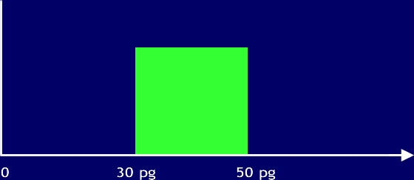
The optimal medical treatment
No menopausal symptoms
No proliferation
Menopausal
Symptoms
Therapeutic
Window
Proliferation of implants
Estradiol level
pg/ml

Slide 57
Medical Treatment
Ovary
Estrogen
Endometriosis
Tissue

Slide 58
Medical Treatment
Progestin
Ovary
Estrogen
Endometriosis
Tissue
Oral contraceptives
Danazol
GnRH agonists

Slide 59
Role of Estrogen in Endometriosis
Estrogen

Slide 60
Role of Estrogen in Endometriosis
Estrogen
Cell growth

Slide 61
Role of Estrogen in Endometriosis
Aromatase
Estrogen
Cell growth

Slide 62
Role of Estrogen in Endometriosis
PGE2
Cytokines
Aromatase
Estrogen
Cell growth

Slide 63
Aromatase In Endometriosis
Aromatase is key for the biosynthesis of estrogen
In patients aromatase expression is higher in endometriosis tissue than in normal endometrium
In endometriosis tissue aromatase activity is stimulated by prostaglandin
Estrogen synthesized by endometriotic tissue stimulates growth of lesions

Slide 64
Role of Estrogen in Endometriosis
Aromatase Inhibitors
Letrozole
Exemestane
Anastrozole
PGE2
Cytokines
Aromatase
Estrogen
Cell growth

Slide 65
Role of Estrogen in Endometriosis
Aromatase Inhibitors
Letrozole
Exemestane
Anastrozole
Danazol
PGE2
Cytokines
Aromatase
Estrogen
Cell growth

Slide 66
Oral Contraceptives
Some women takes contraceptive pills each day all month, without the sugar pills to let her have her period, however, no guidelines exist which regulate the length of time which is safe for the woman to go on taking the contraceptive pills
If a woman does not have her period, then the displaced endometrial cells won’t bleed, which relieves pain and adhesions

Slide 67
Danazol (Danocrine)
. synthetic version of the male hormone testosterone
inhibits the release of FSH and LH by the pituitary gland
decreases estrogen levels similar to menopause, stops ovulation
shrink abnormal implants
improved symptoms in 89% of patients
side effects:
deepening of the voice, abnormal hair growth, reduced breast size, water retention, weight gain (nearly all gain weight between 8-10 lbs.), acne, irregular vaginal bleeding, muscle cramps
it is now shown that danazol does not eradicate endometriosis
it is also shown to be ineffective in long term relief of pain

Slide 68
GnRH Analogs
. depletion of pituitary hormones which regulate the release of estrogen from the ovaries
estrogen level decreases to menopause levels (reversible menopause)
ovulation does not occur
endometrium does not grow
may reduce endo-related pain
Synarel, Lupron, Zoladex.

Slide 69
Synarel (nafarelin acetate)
nasal spray approved in 1990
relieves symptoms and shrinks implant or stops them from growing
puts body into menopausal like state
side effects:
hot flashes; vaginal dryness; lighter, less frequent, or no menstruation; headaches; nasal irritation
should not be used in women who are pregnant, breast feeding, or have undiagnosed vaginal bleeding

Slide 70
Zoladex (goserelin acetate)
created specifically for treatment of endometriosis in 1990
by decreasing the amount of estrogen in the body, the body is induced into a menopausal state
may be administered by a subcutaneous implant which is placed in the abdominal wall

Slide 71
Lupron (leuprolide acetate)
approved by FDA in 1992
subcutaneous injection, nasal spray
side effects similar to synarel
most commonly used GnRH
Lupron, Syranel and Zoladex are more effective that other drugs at relieving pain but are prescribed for no more than six months at a time because of the unpleasant and undesirable side effects

Slide 72
Progestins
progesterone- like drugs, can be injected or taken as a pill
reduce the extent of the endometriosis
not effective in improving fertility
side effects: abnormal uterine bleeding, nausea, breast tenderness, fluid retention, depression
side effects resolve after medication is stopped
most common progestin is medroxyprogesterone
other progestins used include megestrol acetate and norethindrone acetate
used most with women who have already had children because ovarian function can take up to a year or even longer to return to normal after a course of therapy (Begany, 1997)

Slide 73
Pain-Medical therapy
GnRHa vs. Danazol
No difference
GnRHa vs. Progestins
No difference
GnRHa vs. OCP
No difference for pelvic pain, GnRH more effective for dysmenorrhea and dyspareunia

Slide 74
Established Medical Therapy for Total Pain
These drugs are equally effective in reducing the endometriotic implant mass/severity of the disease as well as reducing pelvic pain associated with endometriosis
Initial treatment the choice should be based on cost and side effect profile of the drug
NSAID’s appropriate and successful in many cases
GnRH agonists have been proved effective after the failure of a prior medical hormonal therapy

Slide 75
Suggested approach to endometriosis-associated pain
1st line: continuous low-dose monophasic oral contraceptive with NSAIDs as needed
2nd line: progestins (start with oral dosing, consider switching to levonorgestrel intrauterine device or depo if well tolerated)
3rd line: GnRH agonist with immediate add-back therapy
4th line: repeat surgery, followed by 1, 2, or 3
May consider low-dose (100–200 mg every day) danazol if other therapies poorly tolerated.
Mahutte and Arici, 2003

Slide 76
Experimental Treatments
RU486 (mifepristone) and SPRMs
GnRH antagonists
TNF-a Inhibitors
Angiogenesis Inhibitors
Immunomodulators
Estrogen Receptor-β Agonists
Aromatase Inhibitors

Slide 77
Suggested approach to endometriosis-associated pain
1st line: continuous low-dose monophasic oral contraceptive with NSAIDs as needed
2nd line: progestins (start with oral dosing, consider switching to levonorgestrel intrauterine device or depo if well tolerated)
AROMATASE INHIBITORS with OC or a Progestin
3 rd (4th) line : GnRH agonist with immediate add-back therapy
AROMATASE INHIBITORS with a GnRH analogue
4th (6th) line: repeat or no surgery, followed by 1, 2, or 3 , or AIs with OC, progestin and GnRH analogue

Slide 78
Surgical Treatment

Slide 79
Surgery
Diagnostic surgery
no attempt to treat any of the endo
Very conservative surgery
treatment of a very large, obvious, or treatable area of endo
Aggressive surgery
removes all the endo while preserving the organs
maintains fertility
Radical surgery
removal of the reproductive organs
hysterectomy

Slide 80
Role of laparoscopy
Best evidence suggests that symptomatic relief can be achieved with either medical or surgical therapy for mild to moderate disease.
For severe or nodular disease or for patients with endometriomas, surgical alternatives are most effective.
ACOG technical bulletin
Endometriosis & the endometrium Diamond & Osteen

Slide 81
Surgical Pearls
Identify ureters & bowel first.
Use the avascular spaces.
Work from known to unknown.
Maintain hemostasis moment to moment.
Save the bowel to last if possible.
Be patient.

Slide 82
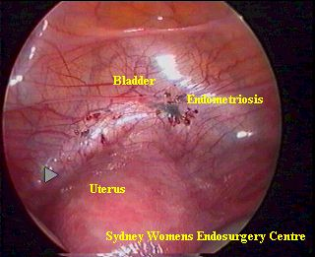
Endometriosis

Slide 83
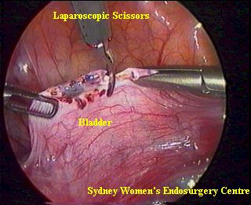
Removal of Endometriosis

Slide 84
Dissection of an Endometrioma
Ovary
Incision
Tube
Removal
Result

Slide 85
Surgery
Presacral and uterosacral neurectomies
where the nerves transporting sensation to the uterus are cut to lessen the pain
Micro-laparoscopy
surgical equipment less than 3mm in diameter
it can be passed through a needle without making an incision
minimal amount of local anesthesia
Laparotomy
more extensive procedure, full abdominal incision, longer recovery period (4-6 weeks)
purpose: perform delicate microscopic surgery

Slide 86
Surgery
Hysterectomy
used only as a last resort
complete removal of the uterus and possibly some of the other reproductive organs
does not guarantee relief from symptoms and pain
endometriosis is one of two leading indicators for hysterectomy for women under the age of 54 (Perloe, 1995)
if both ovaries are not removed, 30% or more women will experience recurrent endo symptoms (Perloe, 1996)
eliminates pain in 90% of cases (Olive and Schwartz, 1993)
following surgery, women usually take hormones to control the endometriosis and help keep it from growing back- hormones also help reduce the pain

Slide 87
Pregnancy
Can cause a temporary remission of symptoms
The patient may be already infertile
women with endometriosis have higher rates of ectopic pregnancies and miscarriages and have more difficult pregnancies and labors
Endometriosis is though to be genetically linked, increasing the risk of hereditary disease process

Slide 88
Alternative treatment
dietary changes
some women have found relief by giving up caffeine, sugar, or alcoholic beverages
incorporate more organic vegetables and fewer processed foods
vitamins and herbs
the B complex vitamins:
improves emotional symptoms of endometriosis
is linked to the breakdown of estrogen in the body
vitamin E and selenium
when taken together, these have been reported to decrease endometriosis-related inflammation
Chinese herbal teas
other people benefit from biofeedback, massage, and acupuncture
remission of symptoms is related to muscle relaxation and stress reduction techniques which involve the power of the mind and body

Slide 89
Psychological Implications
fear of never being free from pain, never getting pregnant, or having a normal life
depression
decreased sex drive because mere anticipation of pain during intercourse can made sex even more painful by increasing anxiety
doubts about sexuality
poor self image
knowledge will give hope and control
education is an empowering tool by which women are enabled to cope with the disease
Suffering in silence, need support networks

Slide 90
Effects on Marriage
sexual dysfunction
painful sexual intercourse
stifles free authentic communication
a woman with endo may feel like her husband is tired of hearing about chronic pain and may stop talking about her true feelings
education of husband
support from husbands
women want to be listened to, to be believed, to be understood, they want the partner to be knowledgeable about the disease, they want the partner to be committed, patient, caring ,to express feelings, to not try to fix the problem, to not judge or blame them and to recognize the impact on the sexual relationship

Slide 91
Medical awareness and Health Care Providers
Many women feel that health care providers are not sympathetic, and many feel victimized
Many women are still being told the pain they feel is in their heads despite the prevalence of the disease
Women need health care providers to listen to them, believe them, be knowledgeable about endometriosis, provide information, not have a condescending attitude, and to recognize that each woman is an individual

Slide 92
Thank You

