Slide 1
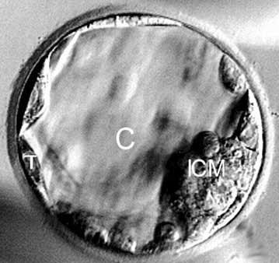
Blastocyst Vitrification: State of the Art
Yasser Orief M.D.
Lecturer of Obstetrics & Gynecology, Alexandria University, Egypt

Slide 2
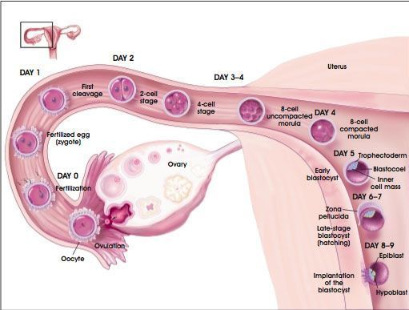
Blastocyst
A blastocyst is a highly differentiated, highly developed embryo that has grown to the point where it is ready to attach to the uterine wall (implantation).
Blastocyst transfer is claimed to be more physiological than pronucleate or cleaved-embryo since it mimics nature more closely..
Notes:
As the embryo advances in the development, after 5-6 days it becomes a blastocyst. The blastocyst has an outer thin layer of cells which will later form the placenta, and an inner cell mass which will develop into the fetus. A blastocyst has about 120 cells

Slide 3
The advantage of using Blastocysts culture and transfer?
• The ability to identify embryos that are well developed and choose one for transfer.
• More adequate synchronization of embryonic stage with the female endometrium.
• Uterine contractions are reduced by day 5 thereby reducing the chance of an embryo being expelled.
• The ability to undertake cleavage stage embryo biopsy which is easier and less harmful when the biopsy blastomere has to be taken.
• Increase implantation rate which need to transfer less number of embryos.
• Blastocyst stage embryos freeze as well, if not better, than cleavage stage embryos.

Slide 4
What might be the disadvantage of using Blastocysts for transfer?
Patient may not have an embryo suitable for transfer.
Increase rate of monozygotic twins

Slide 5
When to offer D5T ?
Patients with either a good response to gonadotropins or with > 4 eight-cell embryos on day 3.
If there is need for embryo biopsy at the cleavage stage for genetic analysis.
Patients who were selected for single embryo transfer.
Patients who had repeatedly failed to achieve a pregnancy following the transfer of good quality cleaved embryos
Patient who do not wish to have their spare embryos frozen for whatever reasons may be advised to have blastocyst transfer.

Slide 6
Blastocyst freezing
With the refinement of extended culture systems, it is becoming more reliable to obtain blastocysts in vitro .
Due their high implantation rates, it is becoming a common practice to limit transfer to one or two blastocysts at a time. Therefore, surplus blastocysts require an efficient cryopreservation method .
Slow freezing was the main method of cryopreservation , but vitrification is now on the rise.
Blastocysts represent a unique challenge in cryostorage due to their size, multicellular structure and presence of blastocoele.

Slide 7
Blastocyst freezing
Vitrification is the glass-like solidification of a solution at a low temperature without ice crystal formation, which is made possible by extreme elevation in viscosity during freezing. This can be achieved by increasing the freezing and warming rates and/or increasing the concentration of the cryoprotectants .
Unlike slow freezing, vitrification results in the total elimination of ice crystal formation, both within the cells being vitrified and outside the cells in the surrounding solution .

Slide 8

Human blastocysts vitrified using different loading devices
During vitrification, the blastocyst is placed in a loading device surrounded by vitrification media. The device is then placed into liquid nitrogen, where it is stored.
There are a variety of loading devices available today:
Open system: Cryoloop, Cryotop and Cryo-leaf
Closed system: Cryoptip, Cut Standard Straws, and High Security Straws.

Slide 9
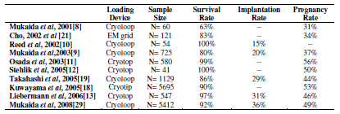
Comparison of survival, implantation and pregnancy rates according to loading device

Slide 10
Obstetric and perinatal outcomes
Multiple pregnancy is the main source of obstetric and perinatal morbidity associated with ART.
Blastocyst transfer allowed one or two blastocysts to be transferred with high implantation potential, while minimizing the risks of multiple pregnancies
There are still concerns regarding the overall safety of vitrification and whether it can cause or lead to chromosomal abnormalities, congenital malformation, and/or developmental abnormalities in the offspring.
Bogliolo L, Ariu F, Fois S, Rosati I, Zedda MT, Leoni G, Succu S, Pau S, Ledda S: Morphological and biochemical analysis of immature ovine oocytes vitrified with or without cumulus cells. Theriogenology 2007, 68:1138-1149.
Notes:
Multiple pregnancy is the main source of obstetric and perinatal morbidity associated with ART. The transfer of blastocysts allowed one or two blastocysts to be transferred
with high implantation potential, while minimizing the risks of multiple pregnancies. Single blastocyst transfer completely avoids dizigotic twin pregnancy

Slide 11
Obstetric and perinatal outcomes
Noyes et al reviewed a total of 58 reports (1986-2008) on 609 live born babies from cryopreserved oocytes (308 from slow-freezing, 289 from vitrification and 12 from both methods). Twelve newborns (1.3%) had birth anomalies, which is comparable to the number of congenital anomalies that occur in naturally conceived infants.
Noyes N, Porcu E, Borini A: Over 900 oocyte cryopreservation babies born with no apparent increase in congenital anomalies. Reprod Biomed Online 2009
Notes:
Part of the problem is a lack of well-controlled clinical trials.

Slide 12
Obstetric and perinatal outcomes
Takahashi et al reported congenital birth defects of 1.4% using vitrified blastocysts which was similar to fresh blastocysts.
Takahashi K, Mukaida T, Goto T, Oka C: Perinatal outcome of blastocyst transfer with vitrification using cryoloop: a 4-year follow-up study. Fertil Steril 2005, 84:88-92.
Mukaida et al analyzed 560 deliveries of 691 healthy babies following the transfer of vitrified blastocysts. The congenital and neonatal complication rate was 3%, which was comparable to that in their fresh blastocysts transfer group (2.3%).
Mukaida T, Takahashi, K., Goto, T., Oka, C.: Perinatal outcome of vitrified human blastocysts in 7 year experience (2670 attempted cycles). Human Reproduction 2008, 23:i48.

Slide 13
Obstetric and perinatal outcomes
No perinatal abnormalities were reported in Liebermann’s report on 348 deliveries following transfer of vitrified blastocysts .
Liebermann J: Vitrification of human blastocysts: An update Reprod Biomed Online 2009, 19 Suppl 2.
These findings may provide preliminary reassurance on the safety of blastocyst vitrification. A final verdict on the actual effect of blastocyst vitrification on congenital and perinatal outcomes may not be possible until large-scale trials or further meta-analysis of rapidly accumulating reports can be performed.

Slide 14
Factors that can affect the outcome
• Pre-vitrification blastocyst selection
• Post-thaw blastocyst selection
• Assisted hatching
• Blastocoele collapse (assisted shrinkage)
• Media protocols
• Freezing rate
• Warming rate
• Operator-dependent factors
• Hydrostatic pressure

Slide 15
Factors that can affect the outcome
Pre-vitrification blastocyst selection
Selection focuses on the quality of the original embryo and/or the time at which the blastocyst is vitrified.
The quality of an early embryo determines the quality of the blastocyst, and therefore the outcome of the blastocyst vitrification. This highlights the importance of following the day-by-day development of each embryo so that the outcome of blastocyst vitrification and later transfer can be predicted.
Notes:
In a study by Vanderzwalmen et al [30], vitrified blastocysts that originated from a cohort of early embryos with less than 30% fragmentation and had survival, implantation and ongoing pregnancy rates of 73%, 32% and 19%, respectively. In contrast, when the blastocysts came from embryos with 30-50% fragmentation and/or unequally sized blastomeres, these rates decreased to 38%, 9% and 6%, respectively.
These findings highlight the importance of following the day-by-day development of each embryo so that the outcome of blastocyst vitrification and later transfer can be predicted.

Slide 16
Factors that can affect the outcome
Day 5 versus day 6 vitrification
Blastulation of human embryos usually occurs on day 5 after fertilization but may be delayed until day 6.
The transfer of fresh day–5 blastocysts seems to result in higher pregnancy rates than he transfer of fresh day-6 blastocysts .
However, the transfer of slowly cryopreserved day-6 blastocysts results in comparable pregnancy rates to the transfer of cryopreserved day-5 blastocysts . This may be related to better endometrial synchrony in the cryopreserved blastocyst transfer cycles; the endometrial receptivity window may be missed in day 6 fresh transfer.
Van Voorhis BJ, Dokras, A.: Delayed blastocyst transfer: is the window shutting? Fertil Steril 2008, 89:31-32.
Notes:
Table 2 summarizes the different studies that have compared day-5 with day-6 blastocyst
cryopreservation.
In different clinical studies, day-5 blastocysts were generally associated with better outcomes
following cryopreservation by vitrification than day-6 blastocysts. Mukaida et al and Veeck et
al reported superior survival rates with blastocysts vitrified on day 5 compared with those
vitrified on day 6 [9, 35]. In a study with 41 vitrified blastocysts, Stehlik et al [12] reported a
pregnancy rate of 50% using vitrified day-5 blastocysts, compared with a 33% pregnancy rate
using day-6 blastocysts. Liebermann and Tucker [13] found that implantation and pregnancy
rates were significantly higher after the transfer of day-5 vitrified blastocysts than after transfer with day-6 blastocysts. However, they did not find a statistically significant difference in
survival rates between the two groups. The results of slow cryopreservation of day-5 versus day-
6 blastocysts were similar, although no statistical significance between the two groups was
reached.

Slide 17
Factors that can affect the outcome
Day 5 versus day 6 vitrification
Day-5 blastocysts have less DNA damage than day-6 blastocysts,
Embryos that undergo blastulation on day 5 would better be vitrified on day 5, while embryos delayed in development may be allowed to develop to day 6 until vitrified.
The rate of development and the degree of expansion are more likely to affect the outcome than the day of vitrification .
After all, transferred vitrified embryos will benefit from a better endometrial synchrony, which may dampen negative effects from cryostorage .
Notes:
The superior outcomes associated with vitrified day-5 blastocysts may be related to the fact that many of the day-6 blastocysts were delayed in development, suggesting that they were of inferior quality. In the case of expanded good quality day 6 blastocysts, damage could still be explained
by an increase in number of blastomeres, increase in their metabolic activity and an increase in
blastocoele expansion.

Slide 18
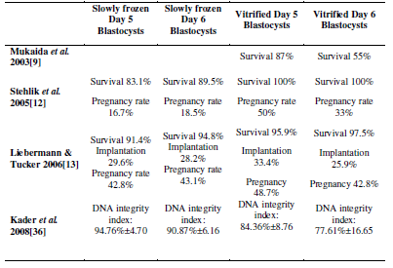
Different studies comparing the slow preservation and/or vitrification of day 5 and day
6 blastocysts in terms of survival after warming, implantation and pregnancy rates

Slide 19
Factors that can affect the outcome
Post-thaw blastocyst selection
Post-warming, viable blastocysts re-expand and are usually allowed four to six hours of incubation to regain their vitality before being transferred.
Re-expansion is the sign of viability.
An important predictor of the transfer of vitrified-warmed blastocyst is the blastocyst re-expansion timing. The earlier the blastocyst expands, the better it is expected to perform after transfer.
Kader A, Agarwal A, Abdelrazik H, Sharma RK, Ahmady A, Falcone T: Evaluation of post-thaw DNA integrity of mouse blastocysts after ultrarapid and slow freezing. Fertil Steril 2099

Slide 20
Factors that can affect the outcome
Assisted hatching
Assisted hatching can be performed prior to vitrification.
Overcome the post-freezing zonal hardening preventing spontaneous hatching
Allows better permeation of the cryoprotectants and better blastocoele dehydration
A significantly positive impact on the post-warming DNA integrity index
Vanderzwalmen P, Bertin G, Debauche C, Standaert V, Bollen N, van Roosendaal E, Vandervorst M, Schoysman R, Zech N: Vitrification of human blastocysts with the Hemi-Straw carrier: application of assisted hatching after thawing. Hum Reprod 2003, 18:1504-1511.

Slide 21
Factors that can affect the outcome
Blastocoele collapse (Assisted Shrinkage)
Much attention has been paid to the volume of the blastocoele prior to vitrification and its effect on the overall success of vitrification.
A negative correlation between blastocelic volume and outcome measures has been attributed to an increased likelihood of intracellular ice formation in an inadequately dehydrated blastocoele . Consequently, a process called assisted shrinkage was developed to reduce blastocelic volume prior to vitrification.
Mukaida T, Oka C, Goto T, Takahashi K: Artificial shrinkage of blastocoeles using either a micro-needle or a laser pulse prior to the cooling steps of vitrification improves survival rate and pregnancy outcome of vitrified human blastocysts. Hum Reprod 2006, 21:3246-3252.

Slide 22
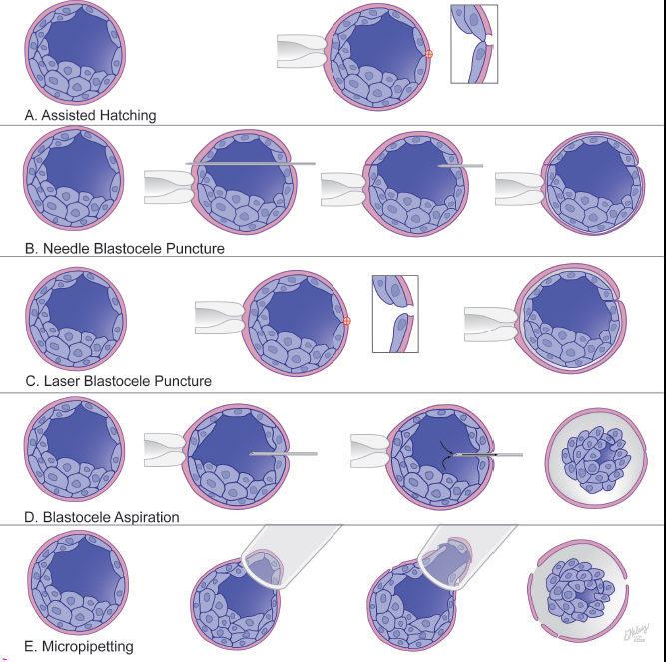
Factors that can affect the outcome
Blastocoele collapse (Assisted Shrinkage)
Notes:
Mukaida et al [41] reported significant improvements in clinical outcome measures in blastocysts that had undergone assisted shrinkage as compared with a retrospective vitrification control group. There were no statistical differences in survival, implantation and clinical pregnancy rates between blastocysts that had undergone laser pulse opening or micro-needle puncture [41].
Vanderzwalmen et al and Son et al have also reported improved results using

Slide 23
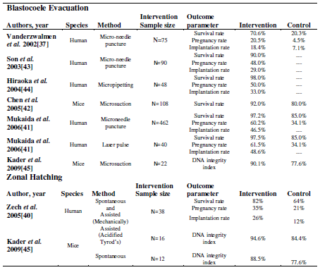
Studies showing different methods of blastocyst pre-vitrification interventions and their outcome parameters.

Slide 24
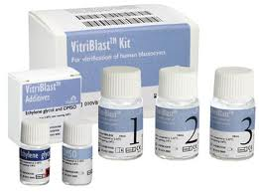
Factors that can affect the outcome
Improvement in media protocols
Single versus multiple cryoprotectants
With two cryoprotectants, the concentration of each can be lower than that needed when either is used separately, thereby making the solution less toxic to the blastocysts.
Notes:
In the early 1990s, investigators often used single exposure to a highly concentrated solution composed of one cryoprotectant. In 1991, Li and Trounson [46] found that the use of dimethyl sulfoxide (DMSO), 1,2-propanediol and glycerol in combination yielded better post-thaw blastocyst survival rate (61%) than when either cryoprotectant was used alone.
With two cryoprotectants, the concentration of each can be lower than that needed when either is used separately, thereby making the solution less toxic to the blastocysts.

Slide 25
Factors that can affect the outcome
Improvement in media protocols
Macromolecules
Extracellular disaccharides and macromolecules, such as sucrose and Ficoll are commonly added to vitrification solutions. This helps
Draw water out of the blastocoele to attain better dehydration and reduce osmotic shock.
The addition of macromolecules also means that the concentration of cryoprotectants can be lowered.

Slide 26
Factors that can affect the outcome
Improvement in media protocols
Single versus multiple steps
A single exposure to a cryoprotectant subjects the blastocyst to an increased risk of osmotic shock, particularly when the concentration is extremely high. Depending on the duration of exposure, a single immersion may not allow enough time for adequate cryoprotectant permeation into the blastocoele. Survival rates after vitrification improved with the evolution of two-step protocols.
Notes:
In the two-step protocols, the blastocyst is allowed to equilibrate for a few minutes at a
lower cryoprotectant concentration before a short exposure to the vitrification solution at a
higher concentration [14]. This enables the cryoprotectants to more gradually and effectively
permeate the blastocysts while reducing the risk of osmotic shock and toxicity. Investigators comparing one-step and two-step protocols demonstrated significantly improved survival rates
ranging from 70% to 90% with the two-step method [48-50].
Survival and hatching rates tend to decline when the concentrations of cryoprotectants become
too high, especially in the blastocyst stage, which requires a delicate balance between high
cryoprotectant delivery and ensuing cellular toxicity. One of the most commonly used protocols
consists of an equilibrium solution of 7.5% ethylene glycol (EG) and 7.5% DMSO mixture,
followed by a vitrification solution of 15% EG and 15% DMSO [13, 41, 44]. Protocols that use
combinations of cryoprotectants at very high concentrations tend to have lower survival and
hatching rates [51, 52].

Slide 27
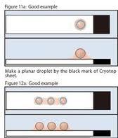
Factors that can affect the outcome
Improvement in media protocols
Media volume
The freezing rate is slower when larger drops are used. Using a small volume of media expedites heat transfer by minimizing the freezing or warming propagation time.
In order to achieve the maximal freezing rates, current vitrification loading devices hold a minimal volume of solution such as the EM grid, cryoloop™, cryotip™, and Cryo-leaf™ high security straws.
Notes:
Theoretically, a very small drop (~5 nL) of pure water should vitrify, if cooled very rapidly [53]. In the presence of impurities or a temperature above the glass transition temperature (-140 °C), ice nucleation is likely to occur. Ice nucleation is a critical event and must be avoided since a single nucleation event in the liquid material before vitrification is reached will trigger crystallization of the specimen [54].
In order to achieve the maximal freezing rates, current vitrification loading devices hold a
minimal volume of solution such as the EM grid, cryoloop™, cryotip™, and Cryo-leaf™ high
security straws.
Currently most acceptable target in designing vitrification loading devices for oocytes or
embryos is to use a small volume (<1 μl) of high-concentration cryoprotectant (~30%), and very
rapid freezing rates of 15,000 to 30,000°C/min [55].

Slide 28
Factors that can affect the outcome
Improvement in media protocols
Freezing rate
A high freezing rate is crucial to achieving proper vitrification and survival. This can be achieved :
Direct contact vitrification
Closed system vitrification
* Design (being ultrathin, containing microvolumes) and by material selection.
* decrease the temperature of the liquid nitrogen.
# Vacuum application over the liquid nitrogen
# Nitrogen slush with a temperature of -210° C
Notes:
A high freezing rate is crucial to achieving proper vitrification and survival. This can be achieved
via direct contact between the sample and liquid nitrogen or indirect contact if the sample is
contained in a closed carrier.
Direct contact vitrification
In this method, a high freezing rate is achieved by avoiding any delay that may be caused by the
carrier walls. This method was considered the gold standard for vitrification until concerns about
liquid nitrogen contamination led researchers to develop closed systems [56, 57]. The EM grid is
an example of an old open method.
Closed system vitrification
In a closed system, the specimen is not allowed to directly come in contact with the liquid
nitrogen. Therefore, a carrier is required to deliver the maximum heat transfer rate to the
contained specimen. Closed containers try to achieve this minimal impedance of heat transfer by
design (being ultrathin, containing microvolumes) and by material selection. The most recent developments in the closed systems are the CryoTip ™ and Cryo-leaf™ the high security straws
(HSS).
Cut standard straws hold blastocysts in a 0.75μl chamber with a freezing rate of 15,000°C/min if
open and 600°C/min if closed. Isachenko et al [58] did not report any difference in the survival
rate of blastocysts vitrified in the open or closed system. This demonstrates that vitrification can
occur at a lower-than-expected freezing rate.
An alternative way to increase the freezing rate is to decrease the temperature of the liquid
nitrogen. This increases the freezing through two mechanisms: (1) the wider difference in
temperature leads to more rapid transfer and (2) it minimizes the chances of insulating gas
bubble formation. Two mechanisms have been described to decrease the nitrogen temperature:
1. Vacuum application over the liquid nitrogen would decrease the liquid nitrogen
temperature to range between -200°C to -210°C as a result of elimination of heating and
evaporation at the liquid /gas interface [54, 59-61].
2. Nitrogen slush with a temperature of -210° C is less likely to evaporate on contact with
the specimen compared to liquid nitrogen, [62].

Slide 29
Factors that can affect the outcome
Improvement in media protocols
Warming rate
Proper warming is as important as rapid freezing to achieve proper vitrification-devitrification
In open methods by mixing the sample in pre-warmed media
In closed methods by plunging the sample in its loading device into a warm water bath.
The heating rate will be controlled by the same factors that control the freezing rate.
Notes:
Proper warming is as important as rapid freezing to achieve proper vitrification-devitrification
[54]. This is usually done with the immediate transfer of the sample to a pre-warmed (37° C)
environment while making sure this temperature is immediately available to the sample. This can
be done in open methods by mixing the sample in pre-warmed media or in closed methods by
plunging the sample in its loading device into a warm water bath. The heating rate will be
controlled by the same factors that control the freezing rate.
Because dilution of the cryoprotectants and re-expansion of the blastocoele occur during the
warming process, it is necessary to perform the process using a series of media with gradually
decreasing osmotic pressure in an effort to reduce osmotic shock [21]. One commonly used
warming protocol uses three steps, beginning with 0.3 mol/L sucrose in base medium, followed
by transfer to 0.2 mol/L sucrose in base medium, and finally to a solution containing only base
medium [41].

Slide 30
Factors that can affect the outcome
Operator factors
The vitrification outcome is highly operator dependent, and it requires a totally different skill set than is needed with slow freezing.
The embryologist should be rapidly handling the embryos in micro-volumes of highly viscous media.
Also, because there are a variety of loading devices available, specific training on the use and storage of a certain device and standardization of quality control procedures is mandatory.
Notes:
Operator factors
The vitrification outcome is highly operator dependent, and it requires a totally different skill set
than is needed with slow freezing. The embryologist should be rapidly handling the embryos in
micro-volumes of highly viscous media. Also, because there are a variety of loading devices
available, specific training on the use and storage of a certain device and standardization of
quality control procedures is mandatory. The embryologist should be well oriented to the
different critical procedural details that can affect the vitrification outcome. Those details can be
summarized as follows:
1. The types and concentrations of cryoprotectants used and their toxicity threshold
2. The temperature of the vitrification solution at exposure
Avoidance of media mixing in multi-step protocols
4. The duration of exposure to the final cryoprotectants before plunging into LN2
5. The rapid loading
6. Sealing in a closed system
7. System validation (loading, sealing, storage)

Slide 31
Future prespectives
Studying different methods to improve vitrification outcome by manipulating the essential factors (Cryoprotectants concentrations, constituents, freezing rate, warming).
The effect of high hydrostatic pressure (HHP) in the
pre-treatment of blastocysts
Notes:
Future perspectives
Researchers are currently studying different methods to improve vitrification outcome by
manipulating the essential factors (Cryoprotectants concentrations, constituents, freezing rate,
warming). The vitrification of embryos has shown to be successful at low cryoprotectant
concentration and increased rate of freezing. [63].
Simultaneously, non traditional tools such as the effect of high hydrostatic pressure (HHP) in the
pre-treatment of oocytes and embryos, including blastocysts to improve vitrification outcomes is
also under investigation. Research has shown that HHP leads to the production of heat shock
proteins in mammalian cells [64], which could potentially provide enough cellular protection to
maintain homeostasis and even improve cryoprotection [65]. The types and amount of such
proteins synthesized in the stressed cells depend on the intensity and type of the heat shock as
well as on the stressed cell type and state.
Recent studies have reported promising results when applying HHP prior to vitrification of
murine blastocysts, mature porcine oocytes and boar semen [39, 66-69]. For example, applying
hydrostatic pressure of 60 MegaPascals (MPa) for 30 minutes then allowing four to five minutes
before vitrification significantly improved the survival and hatching rates of vitrified murine
blastocysts [68].
The pressure level, pressure duration, temperature at time of pressurizing, and recovery time
before vitrification are important parameters that need to be properly identified for oocytes,
embryos, and blastocysts of different species [69]. However, further studies would be required to
fully understand and control this phenomenon as well as to standardize its use. The use of high
hydrostatic pressure before vitrification is still under investigation.

Slide 32
Future prespectives
HHP leads to the production of heat shock proteins in mammalian cells , which could potentially provide enough cellular protection to maintain homeostasis and even improve cryoprotection.
Applying hydrostatic pressure of 60 MegaPascals (MPa) for 30 minutes then allowing four to five minutes before vitrification
The pressure level, pressure duration, temperature at time of pressurizing, and recovery time before vitrification are important parameters that need to be properly identified for oocytes, embryos, and blastocysts of different species

Slide 33
Take home message
Vitrification of blastocysts can eventually replace slow freezing of blastocysts as suggested by various reports in the literature
Though effect on perinatal outcome has not been fully investigated due to the novelty of the technique in clinical practice, however, the available data supports its potential safety.

Slide 34
Take home message
Other than the patient clinical parameters, the clinical success of transferring vitrified blastocysts would rely on a multitude of factors.
The selection of a good quality embryo on preferably day 5 post fertilization is the 1st step.
The selection of blastocysts that show earlier re-expansion post-thaw for transfer could improve the outcome from transferring vitrified blastocysts.

Slide 35
Take home message
The assisted hatching and induction of blastocoele collapse prior to vitrification have also shown to improve the blastocyst vitrification outcome.
Current media protocols and loading devices are capable of achieving proper vitrification attaining high level of viscosity and dehydration of the blastocysts and delivering high freezing and warming rates.
Finally, the embryologist training would have a major bearing on the vitrification outcome.

Slide 36
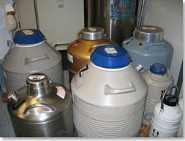
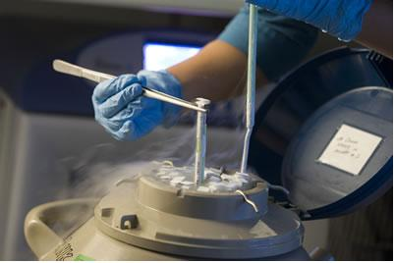
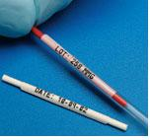
THANK YOU FOR YOUR
ATTENTION

